Slide 1
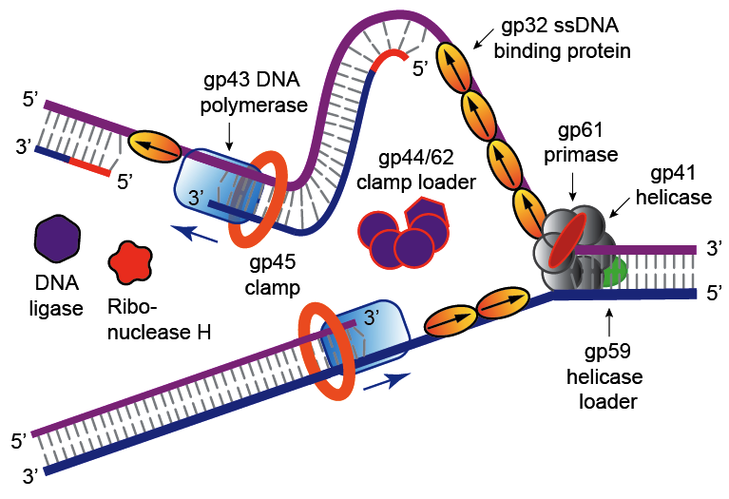
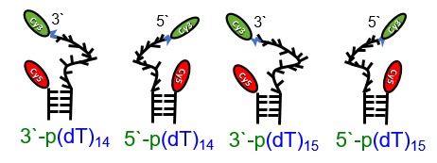
Marcus / von Hippel Group Meeting
Summer 2019
How the geometry of the DNA primer/template junction influences the mechanism of dimerization of T4 SSB gp32
Also: Characterizing the timescales of ssDNA fluctuations
Brett Israels, University of Oregon, August 9th, 2019

Slide 2

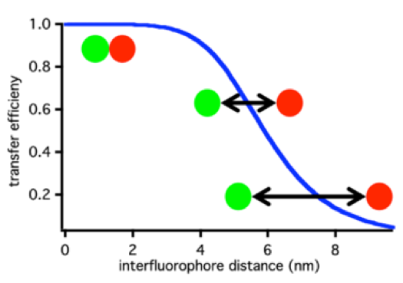
Outline
Background: T4 Bacteriophage DNA Replication system: single stranded (ss) DNA binding protein (SSB) gene-product 32
Methods: single-molecule FRET spectroscopy
Modes of Analysis: Time correlation functions
Results: Differences between constructs
Moving forward: Finishing analysis
gp32
FRET Efficiency vs Distance

Slide 3
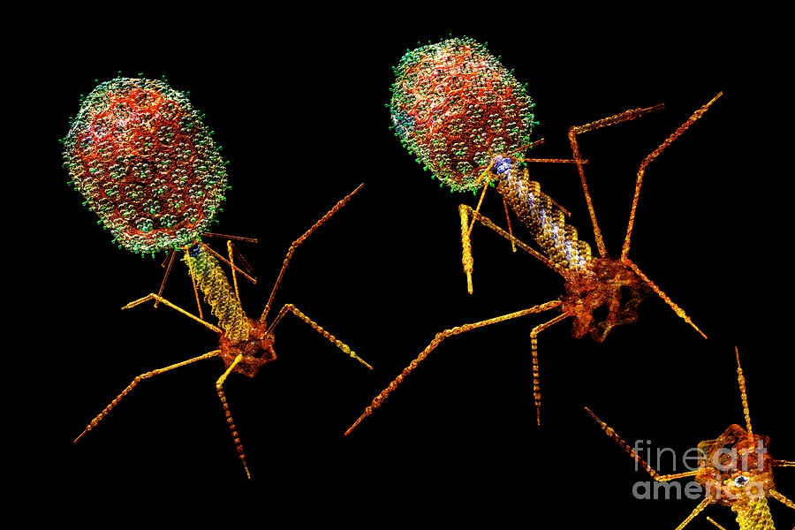
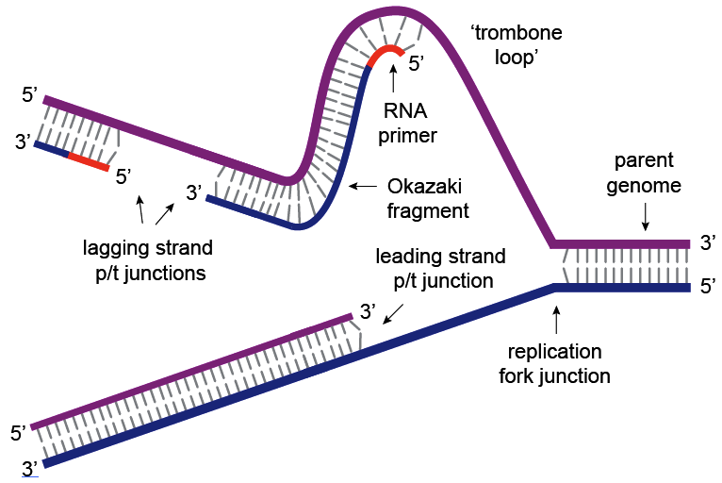
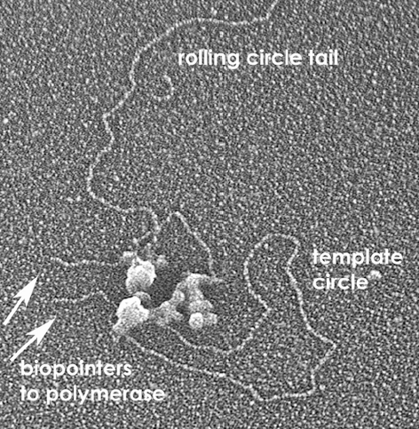
The T4 DNA replication system
A model system for protein machine assembly,
and function in higher organisms
T4 bacteriophage
(infects E. coli)
Electron micrograph of the T4 replisome at a DNA replication fork showing the ‘trombone loop’
J. D. Griffith, J. Biol. Chem. 2013, 288: 29724-35.

Slide 4
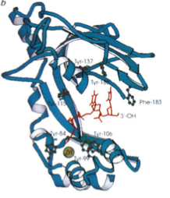
Properties of Single-Stranded DNA Binding Protein: gp32
C-terminal
domain
Regulates Binding
33.5 kDa
gp32 core
domain
N-terminal
domain
Core
protein-protein
interaction
Shamoo Y, et al., Nature (1995)
Protects exposed ssDNA from nucleases.
Melts out secondary structures formed by ssDNA.
Configures the ssDNA templates favorably for other replisome proteins to access (enhances polymerase activity)
Plays roles in DNA repair and recombination
Notes:
Nterminal domain of gp32 interacts with the core of another gp32 to bind more tightly.
C terminus is IDR of protein.

Slide 5

Four ssDNA Fork constructs in different [gp32]
Single-stranded DNA of Two Different Polarities: 3` vs 5`
Cy3
3`
Cy5
DNA only
Cy3
3`
Cy3
5`
Cy5
Cy5
0.1 uM gp32
3`-p(dT)₁₅
5`-p(dT)₁₅
S1S2
S4S5
Single-stranded DNA of Two Different Lengths: 14mer vs 15mer
Cy3
3`
Cy3
5`
0.5 uM gp32
Cy5
Cy5
3`-p(dT)₁₄
5`-p(dT)₁₄
High
[SSB]
S18S2
S19S5
1.0 uM gp32

Slide 6
Single-Molecule FRET: Förster Resonance Energy Transfer
Excited state donor can donate energy to ground state acceptor
FRET Efficiency vs Distance
Cy3 (FRET Donor) and its FRET Pair Cy5 (FRET Acceptor)
κ_{FRET}
Donor
Acceptor
Calculate FRET from Experiment
Advanced fluorescence microscopy techniques—FRAP, flip, flap, FRET and film, Molecules (2012) 17(4):4047-132
Notes:
MAKE SURE TO SAY THE DEFINITION OF FRET
In the forster limit the energy of reaction is small in comparisson to kt so this is a stochastic process. Not adiabatic hopping. The E describes a probability!

Slide 7
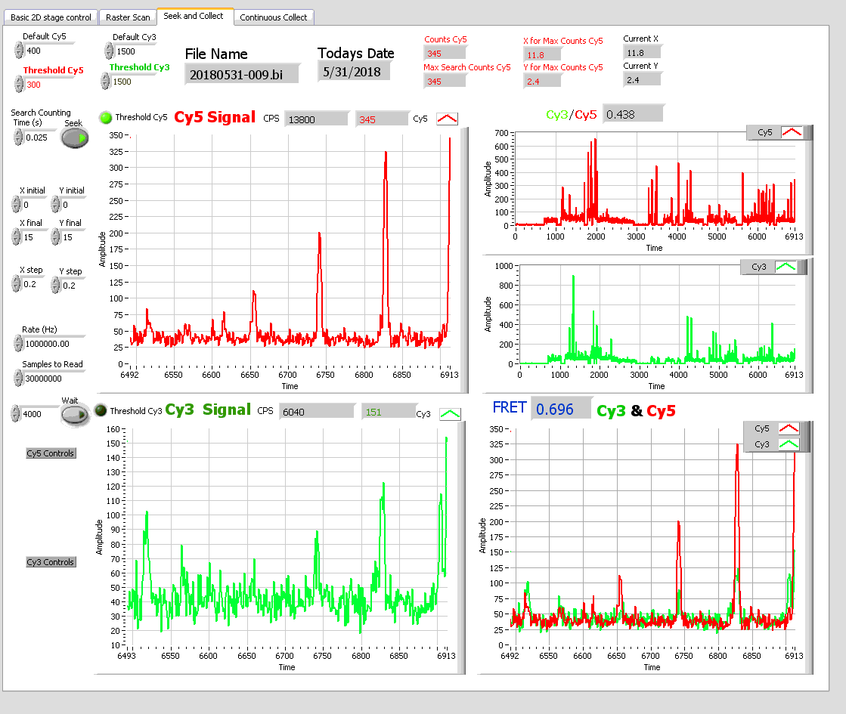
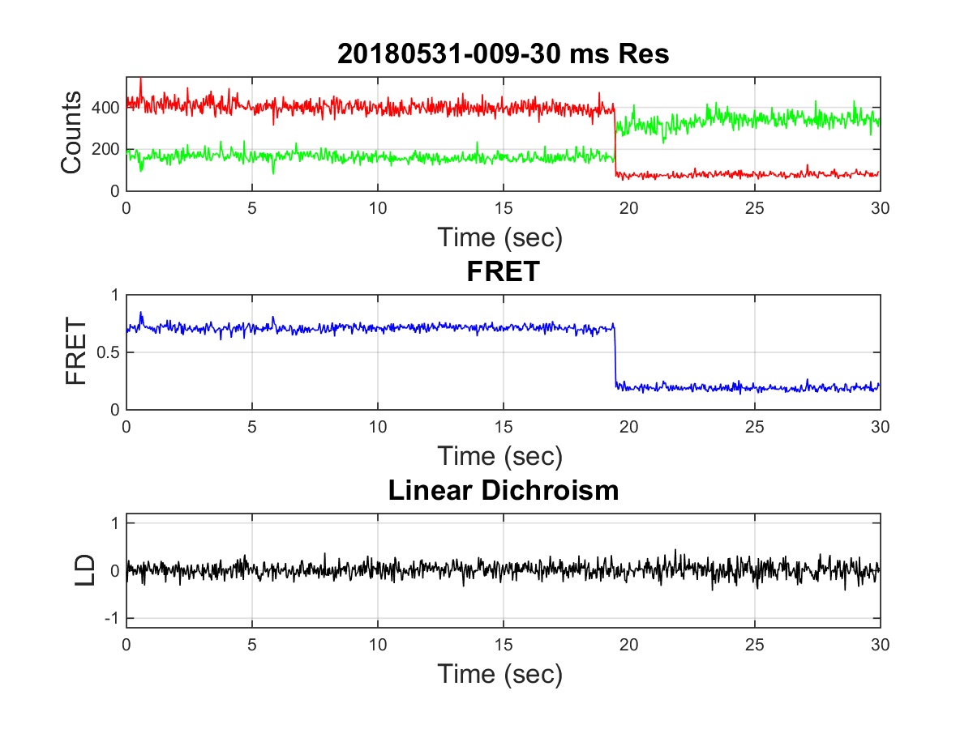
Single-Molecule FRET on the 5`-pdT₁₅
DNA only

Slide 8
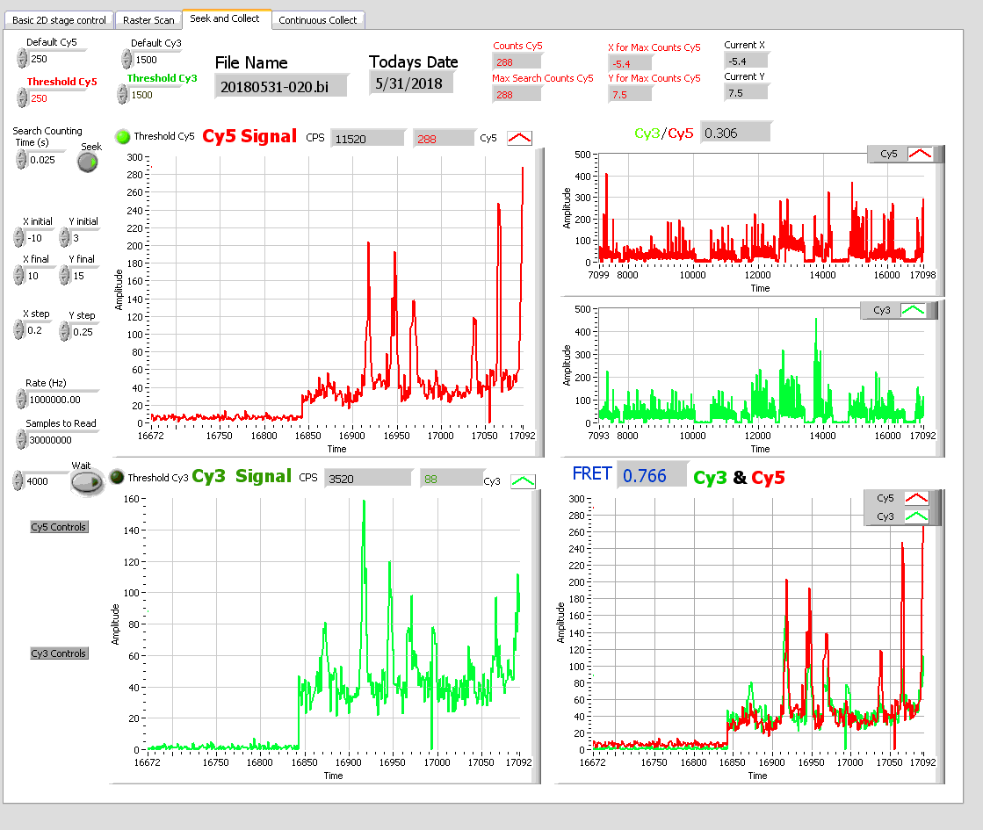
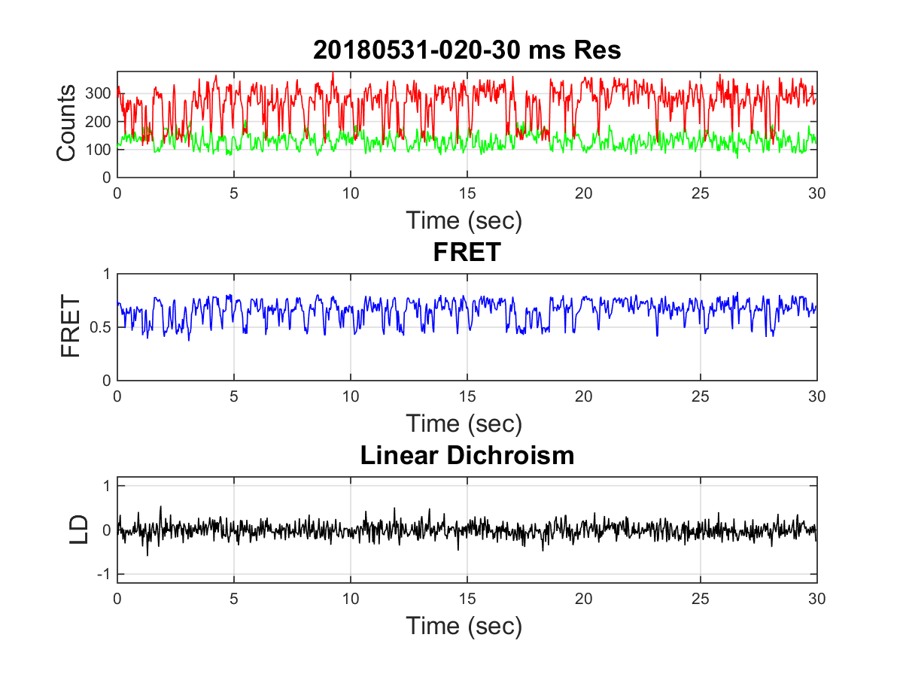
Single-Molecule FRET on the 5`-pdT₁₅
0.5 uM gp32

Slide 9
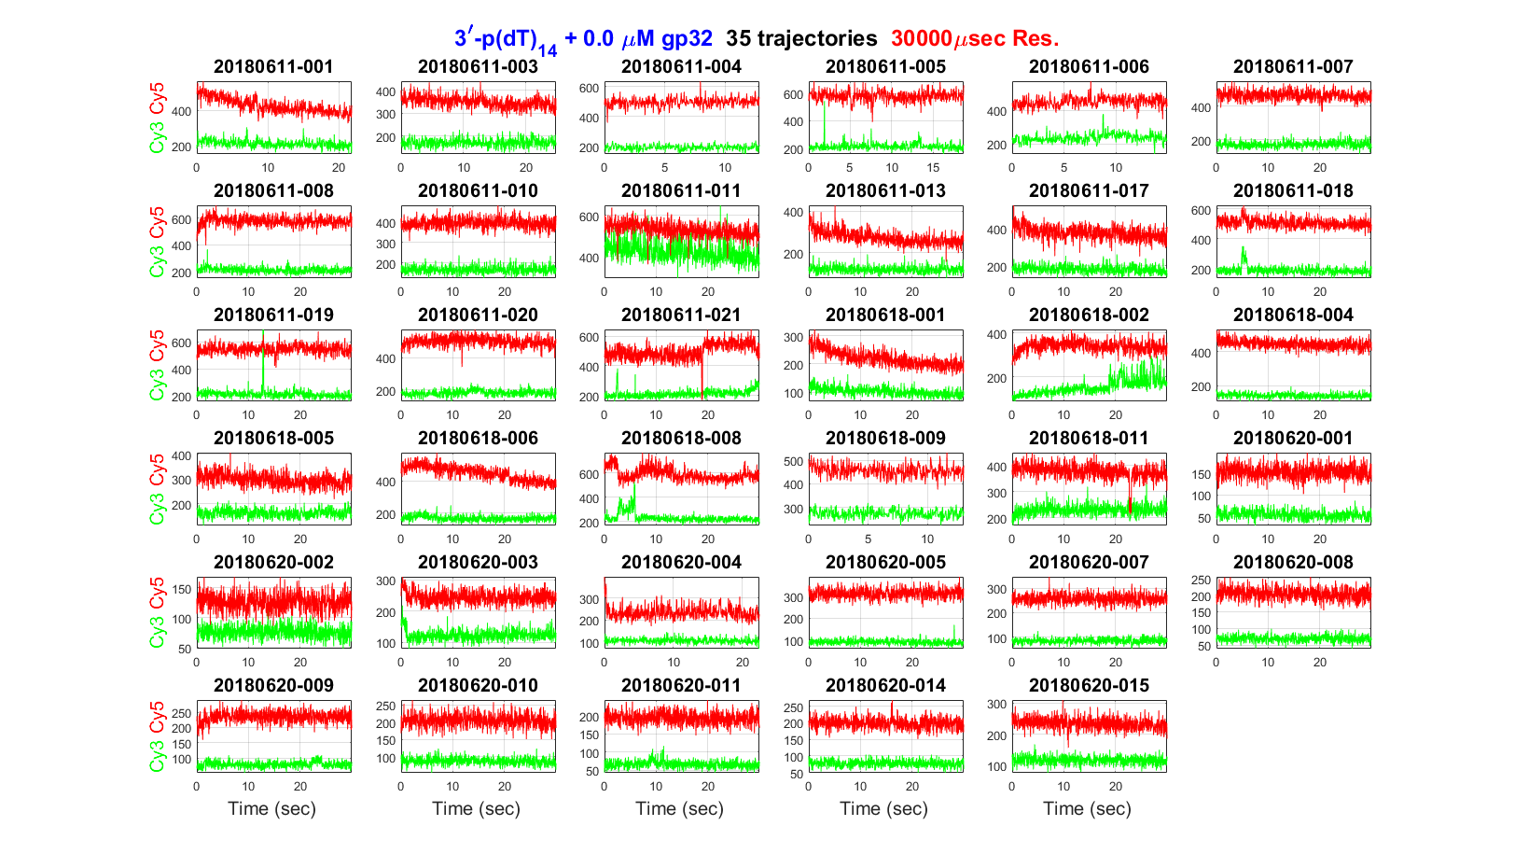
Single-Molecule FRET on the primer-template junction
DNA only

Slide 10
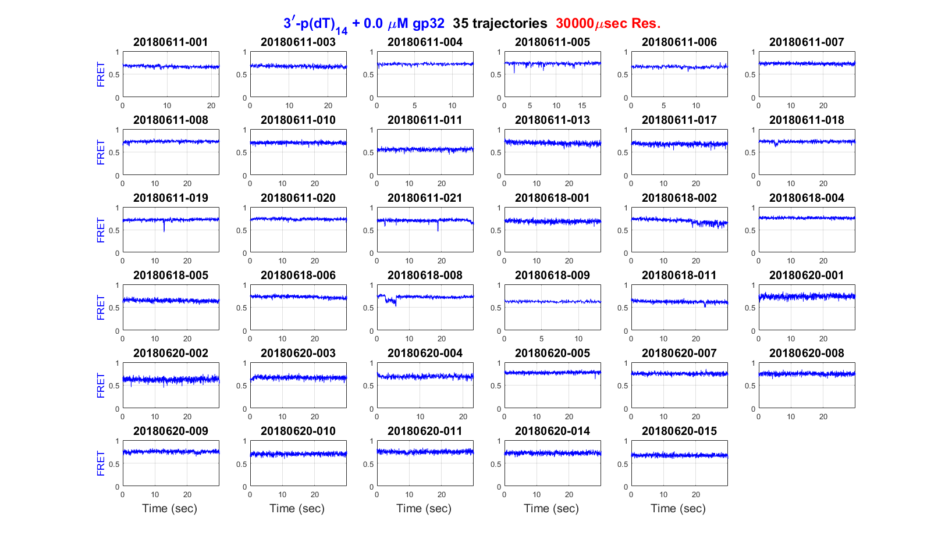
Single-Molecule FRET on the primer-template junction
DNA only

Slide 11
Single-Molecule FRET on the primer-template junction
0.5 uM gp32

Slide 12
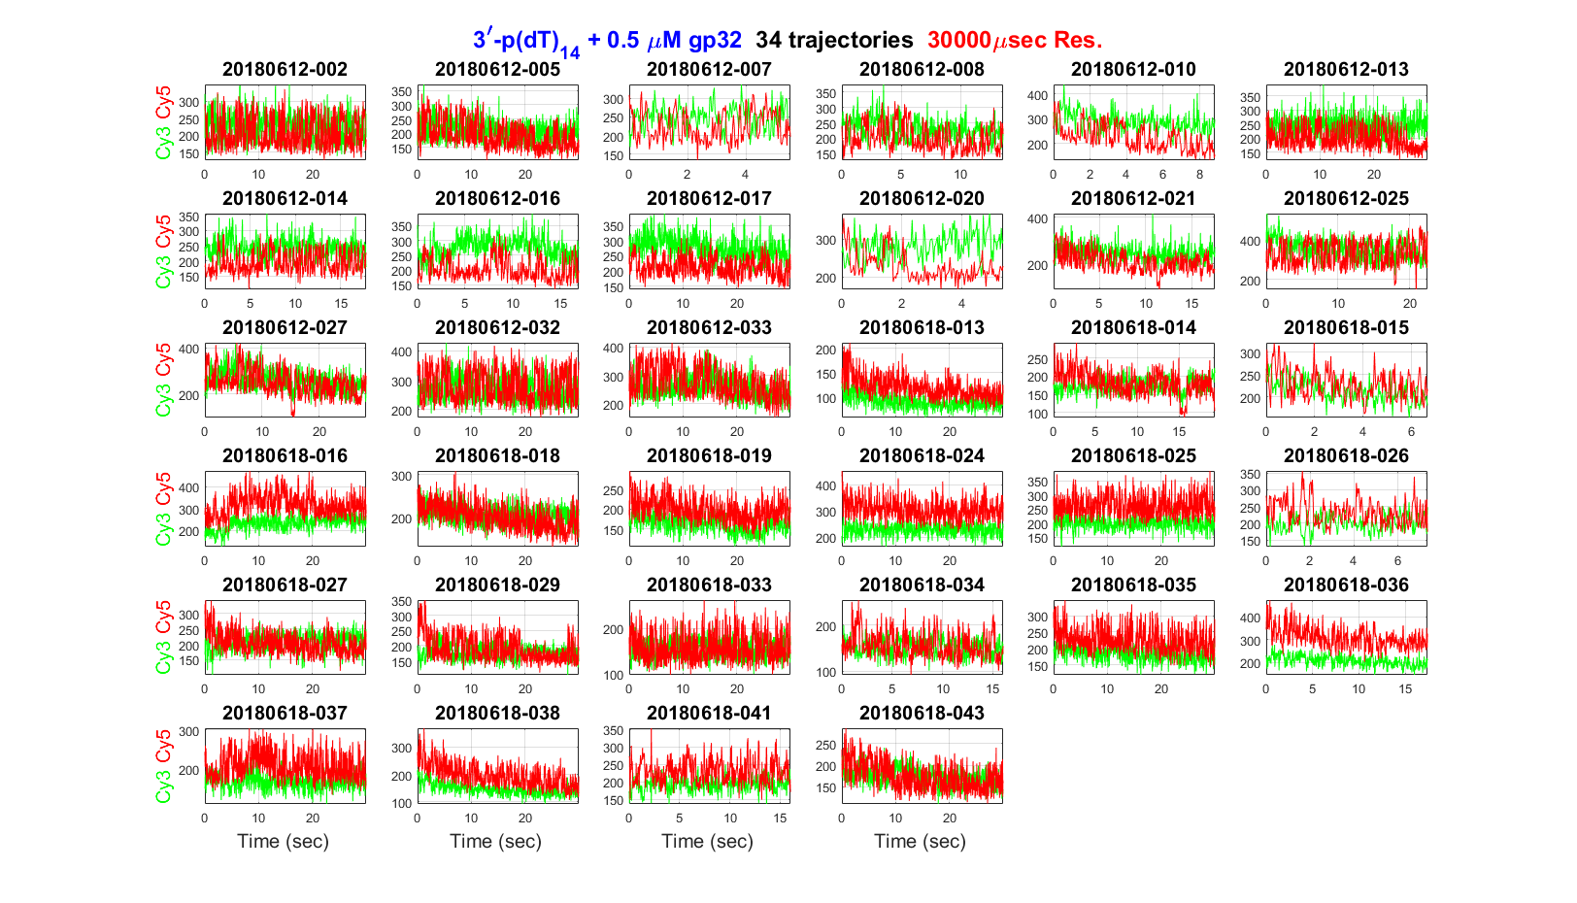
Single-Molecule FRET on the primer-template junction
0.5 uM gp32

Slide 13
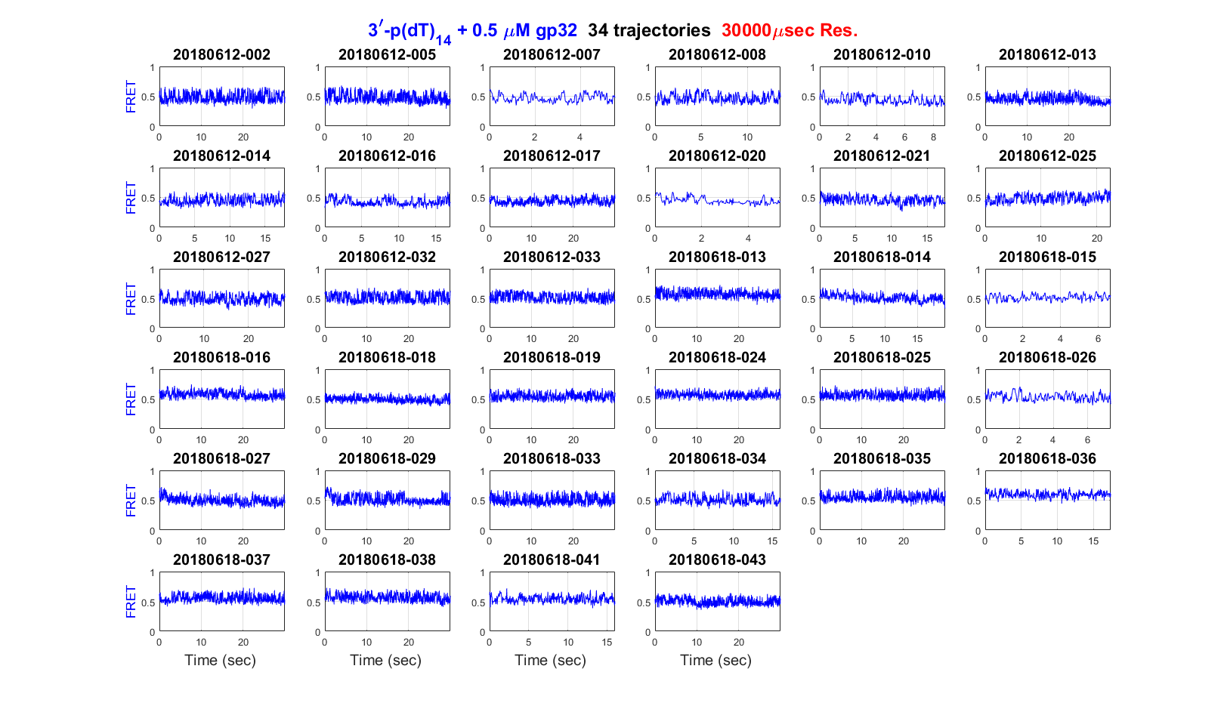
Single-Molecule FRET on the primer-template junction
0.5 uM gp32

Slide 14
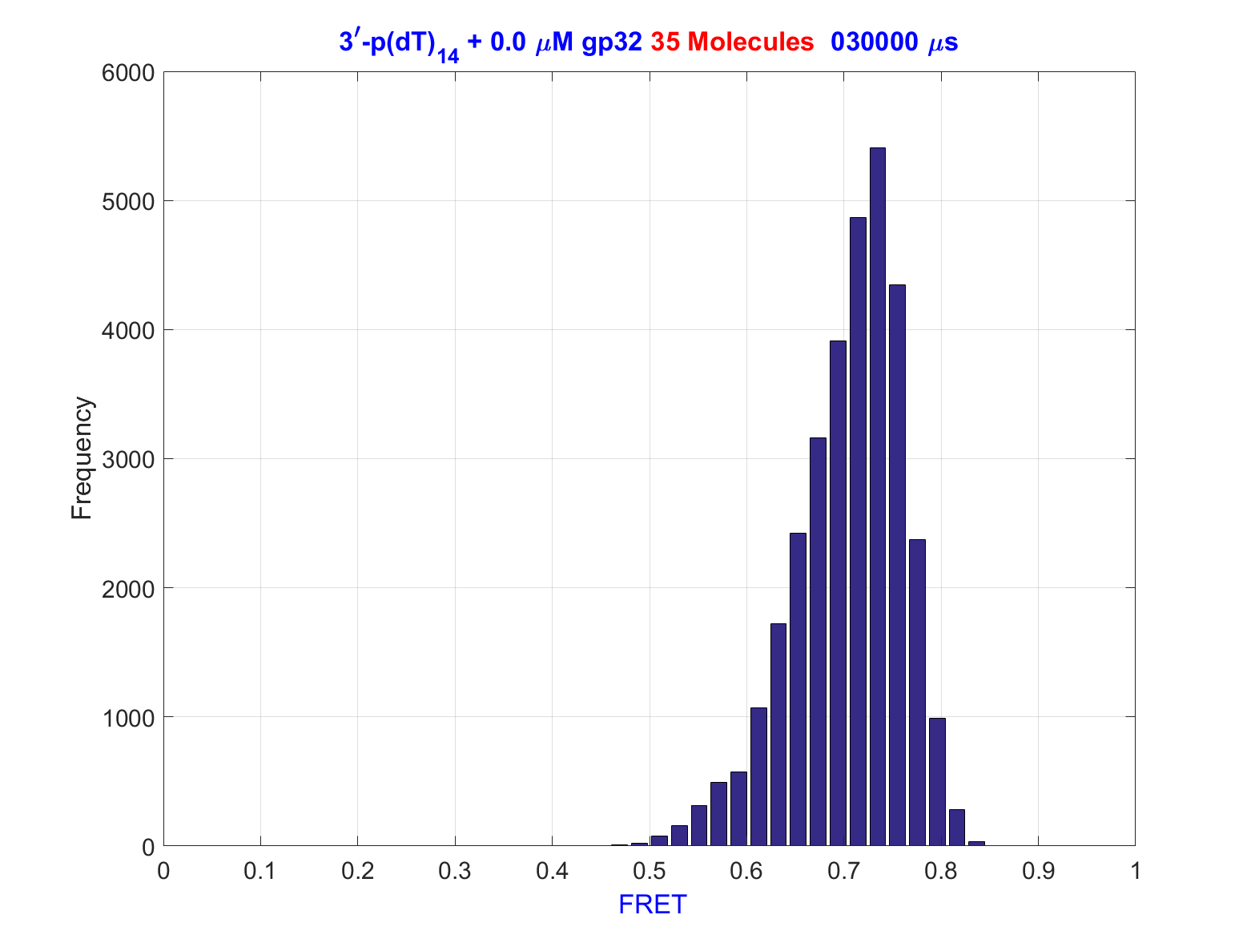
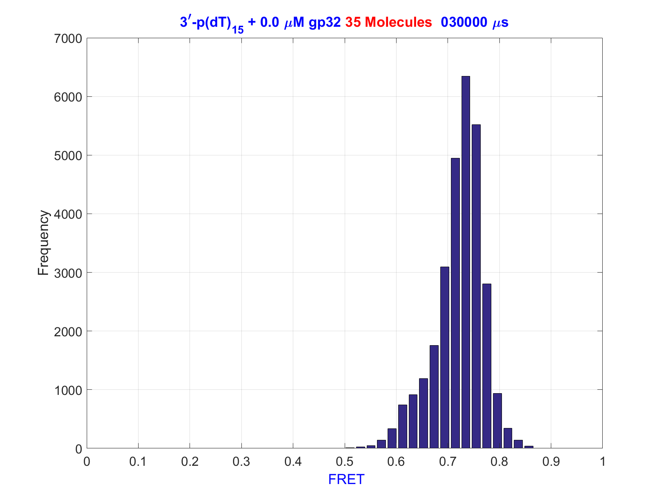
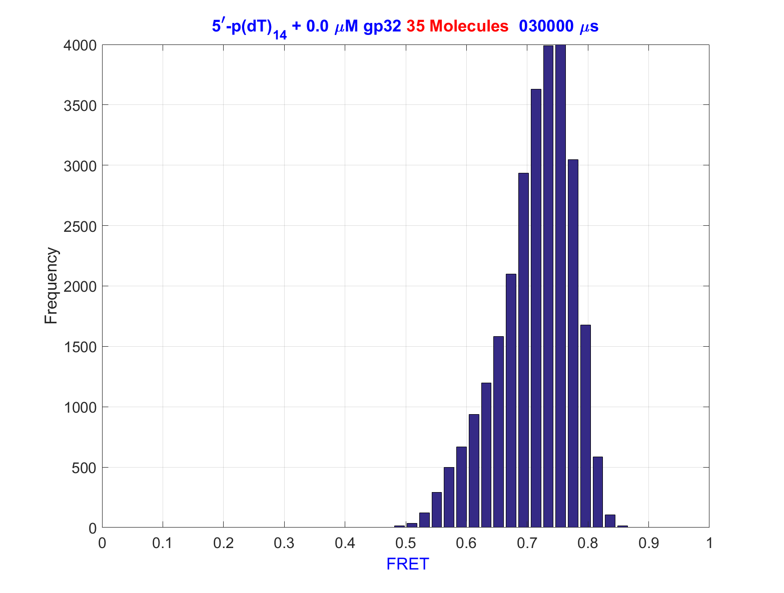
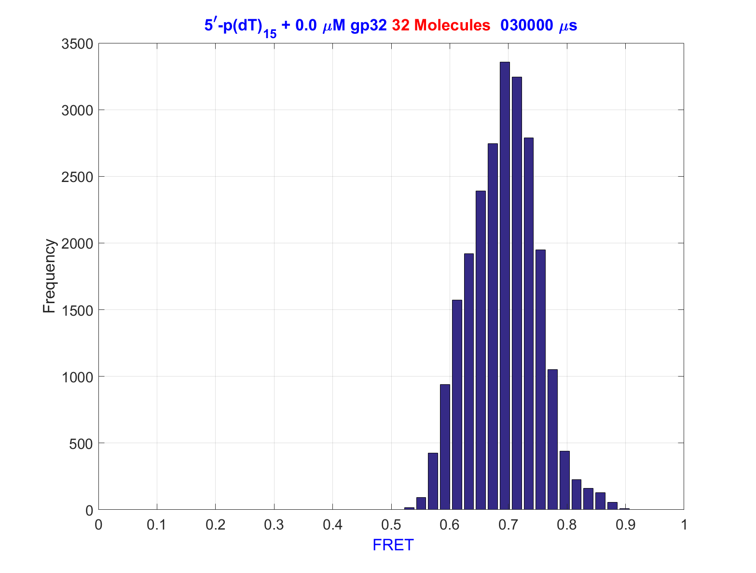
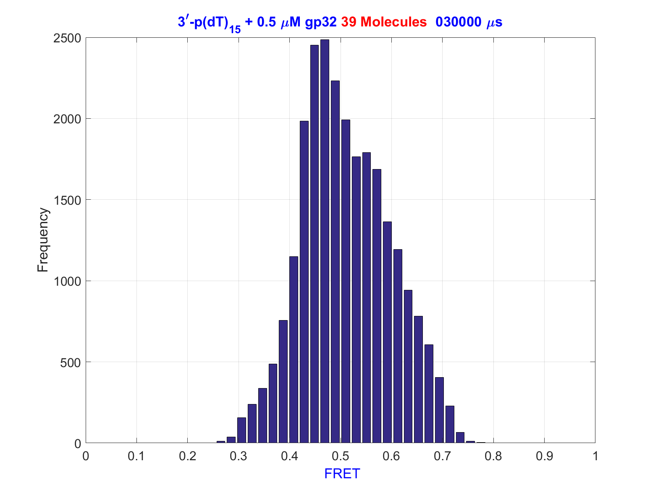
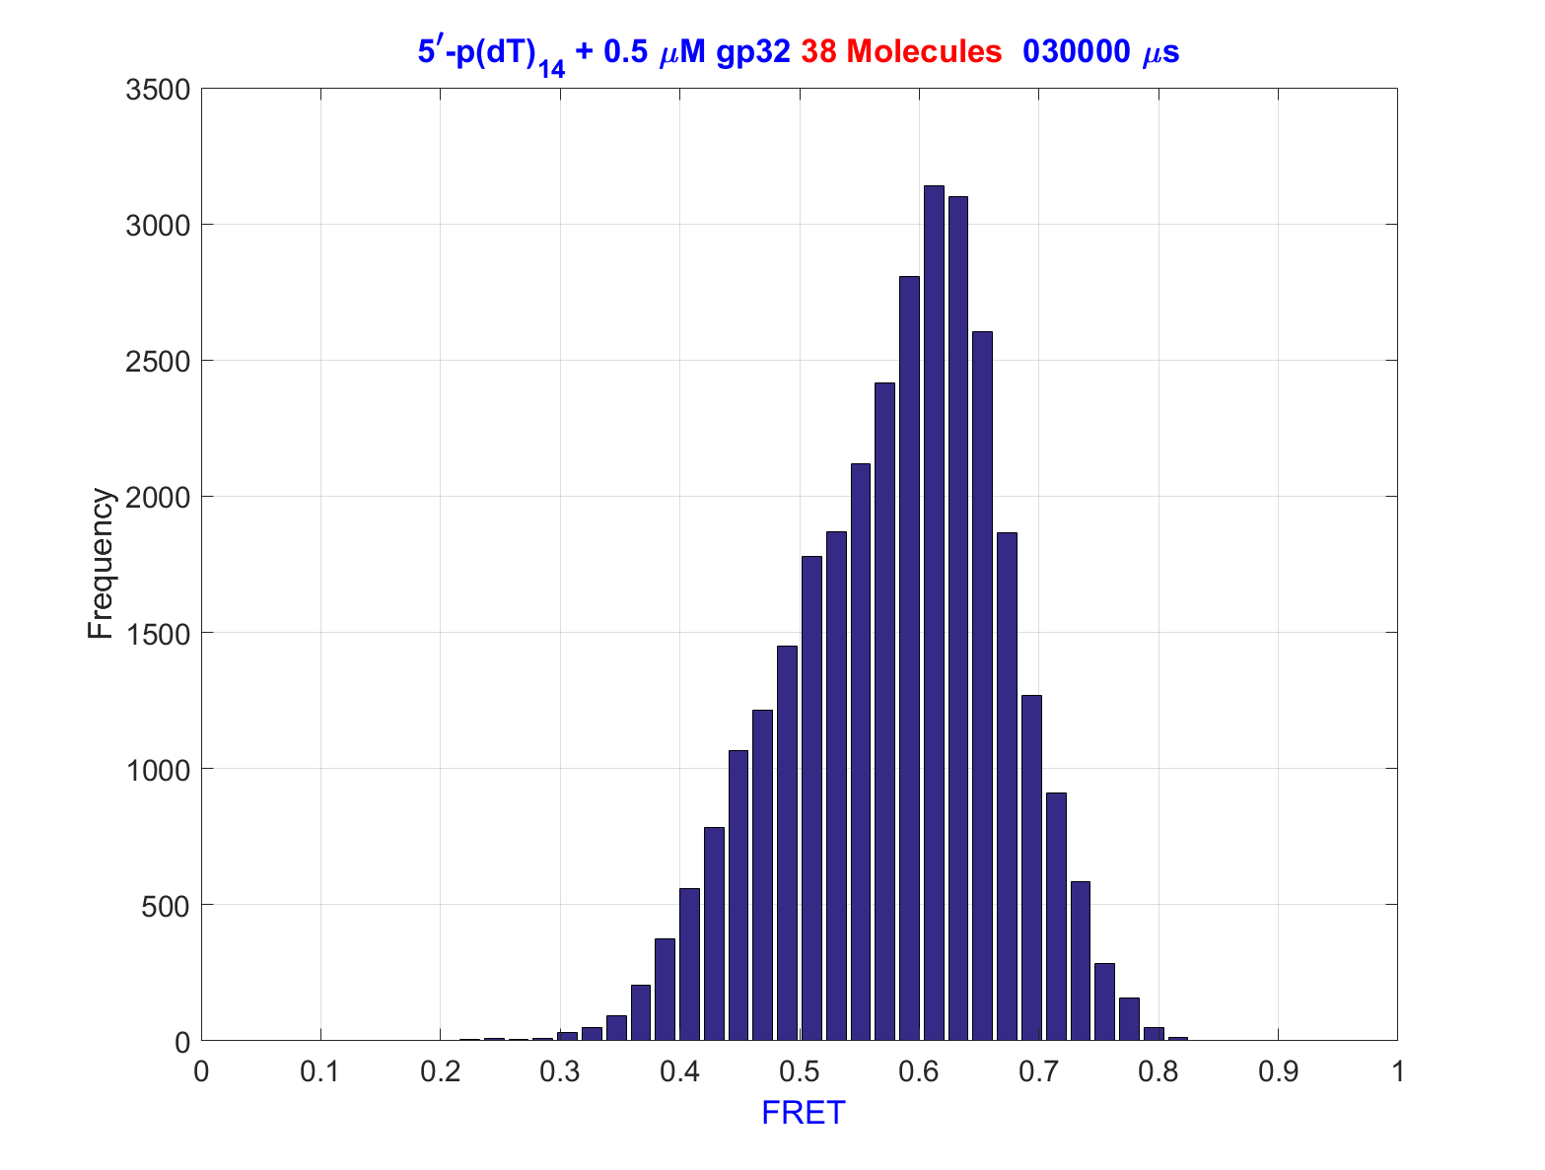
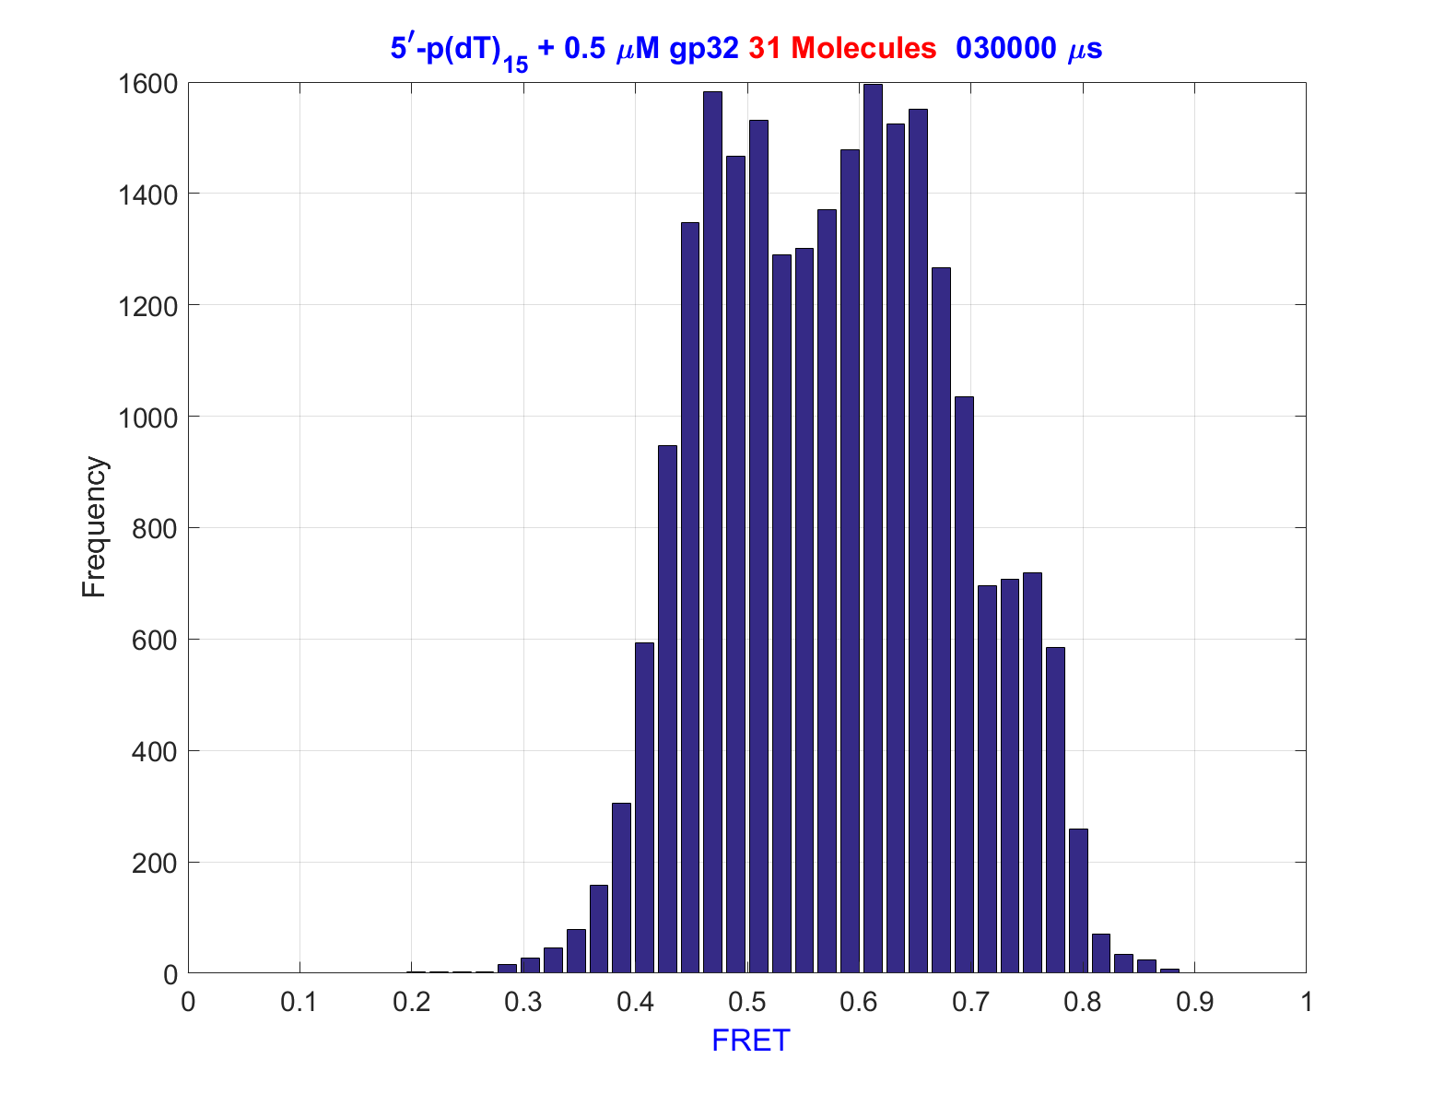
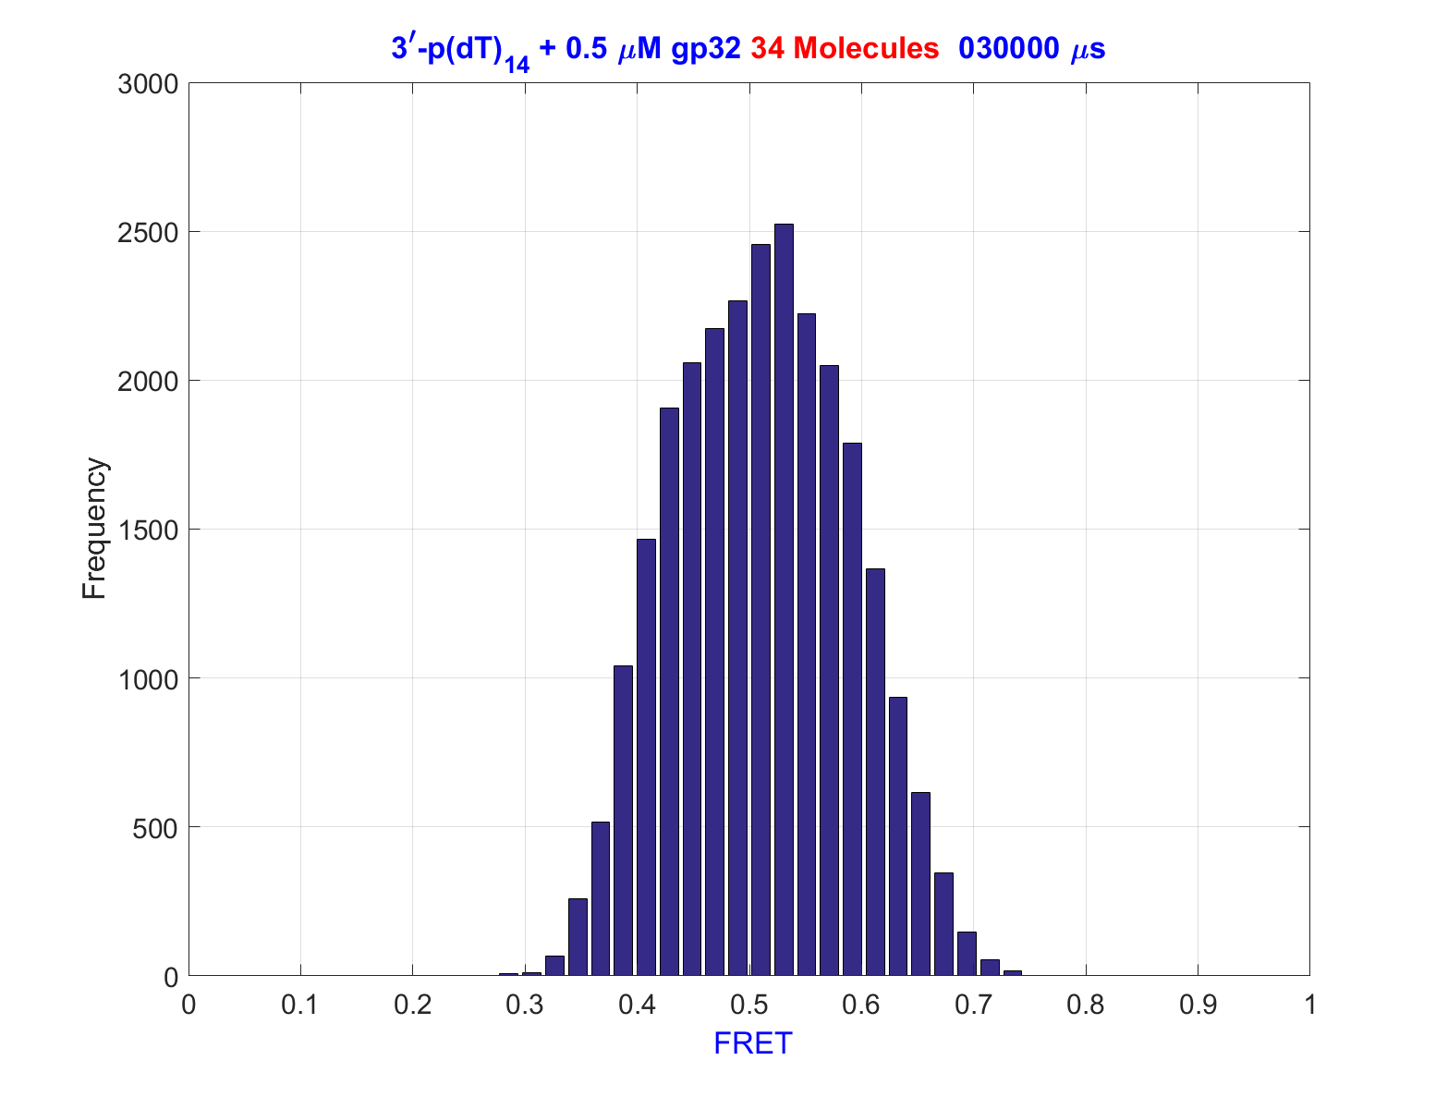
Distribution of FRET States / Conformational States
3`-p(dT)₁₄
3`-p(dT)₁₅
5`-p(dT)₁₄
5`-p(dT)₁₅
Comparison of ssDNA-Fork Junction Constructs

Slide 15
Hierarchy of possible fluctuations in DNA
Cy3
More local motions
Faster Fluctuations
1) Photophysics of the dyes
2) Local Stacking /Unstacking Interactions
Cy5
3) Concerted global rearrangements of the ssDNA
4) DNA-Breathing fluctuations at the junction
More global motions
Slower Fluctuations
Fluctuations at the DNA Fork Junction

Slide 16
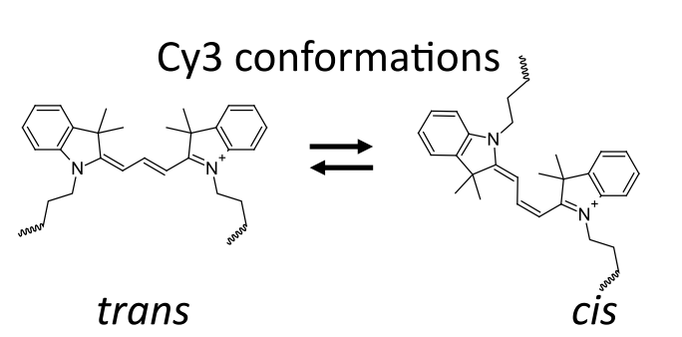
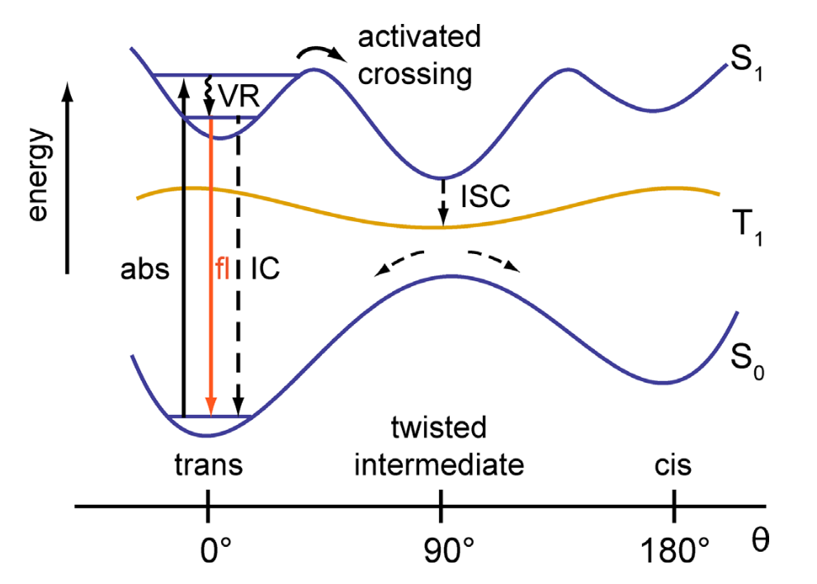
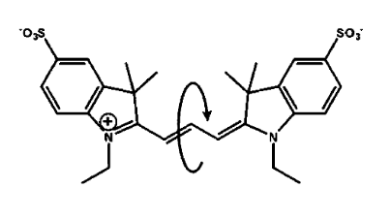
Hierarchy of possible fluctuations in DNA
Cy3
1) Photophysics of the dyes (nanoseconds-microseconds)
Hypothetical Potential energy surface
Excited singlet state
Protein Environment and DNA Orientation Affect Protein induced Cy3 Fluorescence Enhancement (PIFE). 2019 Nguyen, Lohman BPJ
Cy5
Triplet state
Ground state
Reaction coordinate ϴ specifies rotation about the C-C Bond of Cyanine Dyes
Lee, W., Von Hippel, P. H., & Marcus, A. H. (2014). Internally labeled Cy3/Cy5 DNA constructs show greatly enhanced photo-stability in single-molecule FRET experiments. Nucleic Acids Research
Photophysics
Notes:
Note: Can do viscosity experiments to see how this changes the timescales of various processes. I.e. using PEG to simulate crowding of the cell.

Slide 17
Hierarchy of possible fluctuations in DNA
Cy3
1) Photophysics of the dyes (nanoseconds-microseconds)
Hypothetical Potential energy surface
Excited singlet state
Protein Environment and DNA Orientation Affect Protein induced Cy3 Fluorescence Enhancement (PIFE). 2019 Nguyen, Lohman BPJ
Cy5
Triplet state
Ground state
Reaction coordinate ϴ specifies rotation about the C-C Bond of Cyanine Dyes
Lee, W., Von Hippel, P. H., & Marcus, A. H. (2014). Internally labeled Cy3/Cy5 DNA constructs show greatly enhanced photo-stability in single-molecule FRET experiments. Nucleic Acids Research
Photophysics
Notes:
Photoisomerization of the C-C bond in the polymethine chain of the excited state Cyanine molecule yields a non-fluorescent ground state photoisomer (the cis- configuration).
Conversion back to the trans- state can take micro- to milliseconds depending on the local environment.

Slide 18
Photophysics of the Cyanine Fluorophores
Hypothetical Potential energy surface
Excited singlet state
Triplet state
Protein Environment and DNA Orientation Affect Protein induced Cy3 Fluorescence Enhancement (PIFE). 2019 Nguyen, Lohman BPJ
Ground state
Reaction coordinate ϴ specifies rotation about the C-C Bond of Cyanine Dyes
Lee, W., Von Hippel, P. H., & Marcus, A. H. (2014). Internally labeled Cy3/Cy5 DNA constructs show greatly enhanced photo-stability in single-molecule FRET experiments. Nucleic Acids Research
Notes:
The ground state surface is labeled S0, the excited singlet state is labeled S1 and the excited triplet state is labeled T1.

Slide 19
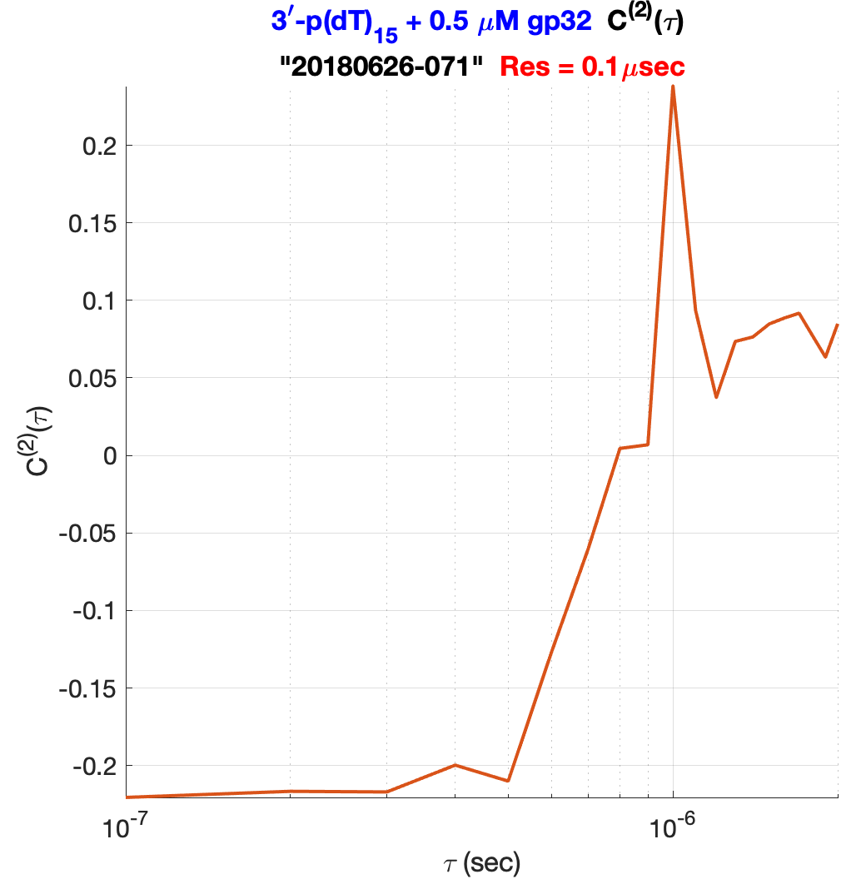
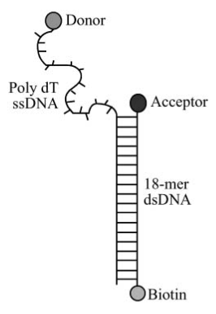
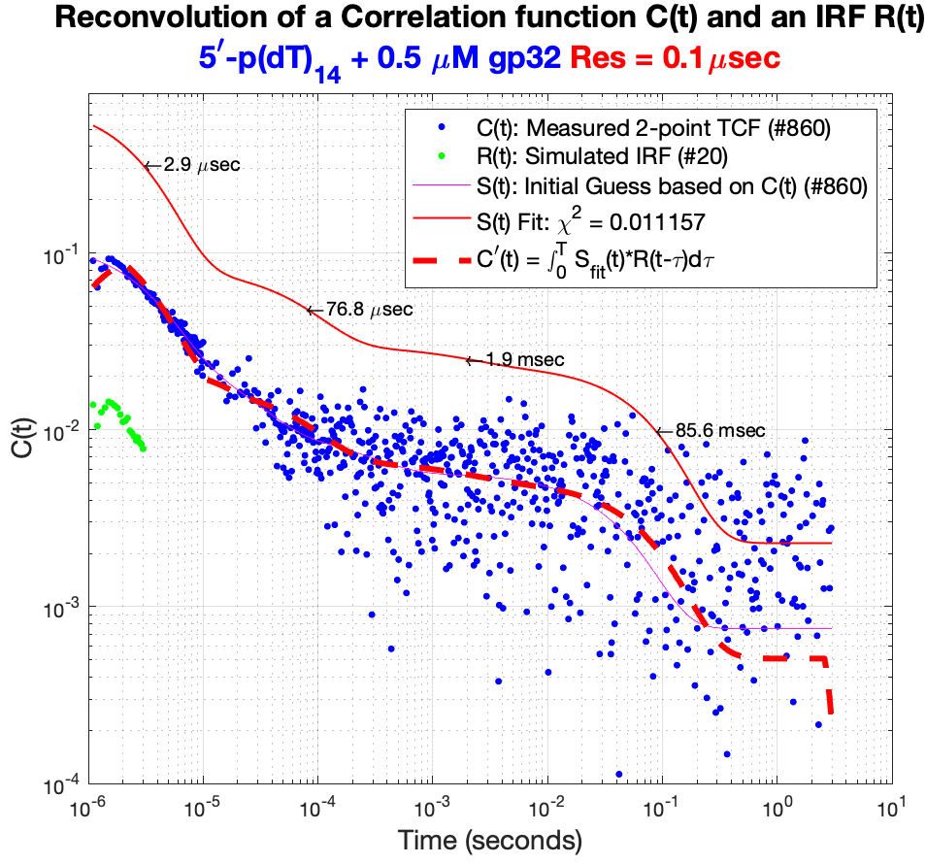
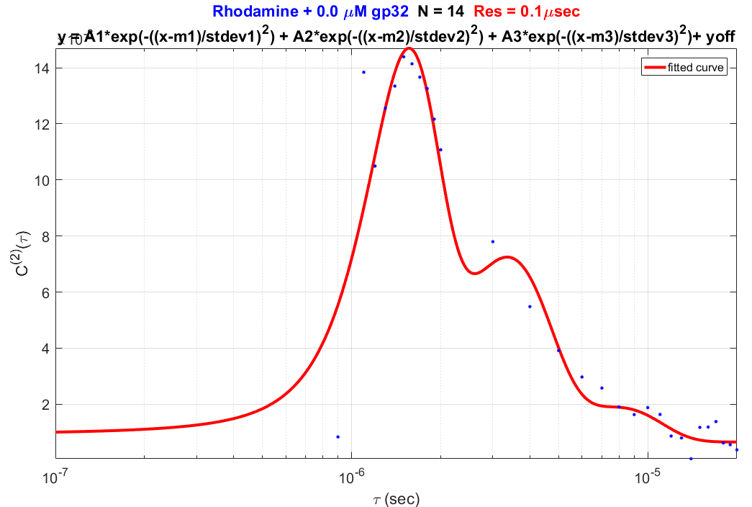
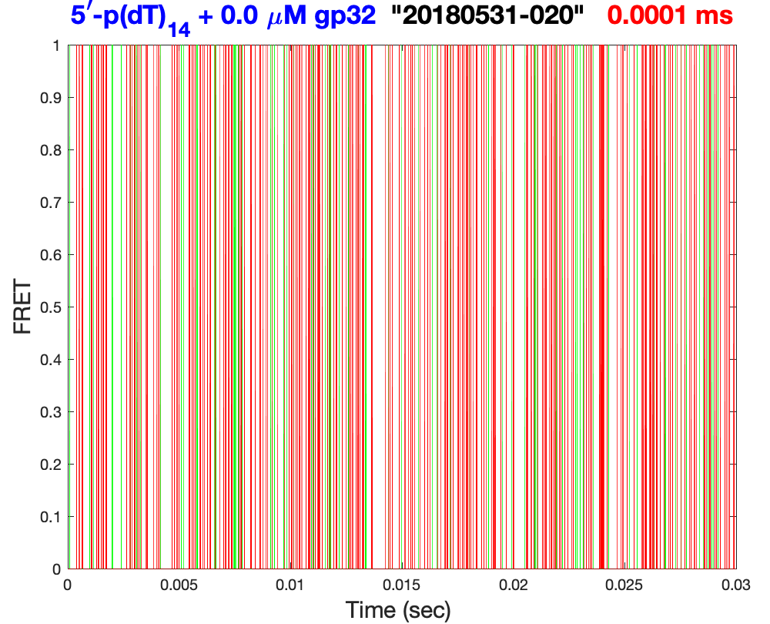
Sub-microsecond Resolution Single Molecule FRET
Fig 4: 2point TCF at 100 nanosecond resolution
Fig 1: Entire trajectory at 30 msec resolution.
Rhodamine B
Fig 6. Least Squares Iterative Reconvolution removes the IRF from the measured 2-point TCF
Fig 3: First 30 msec at 100 nanosecond resolution.
Fig 5: Measured Instrument Response Function (IRF)
Removal of the Instrument Response Function

Slide 20
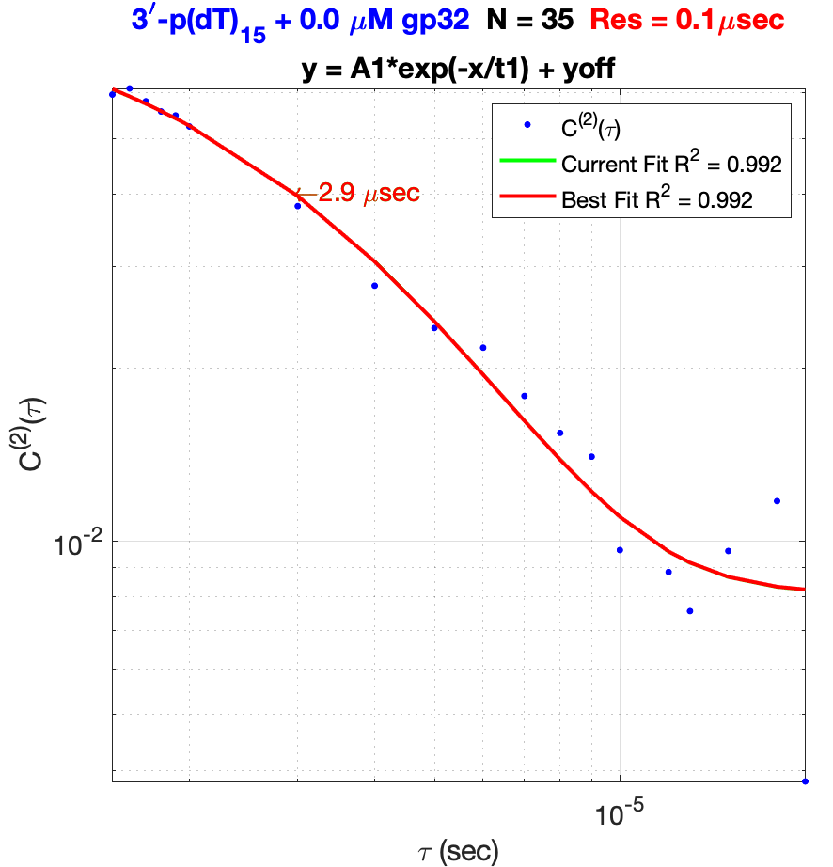
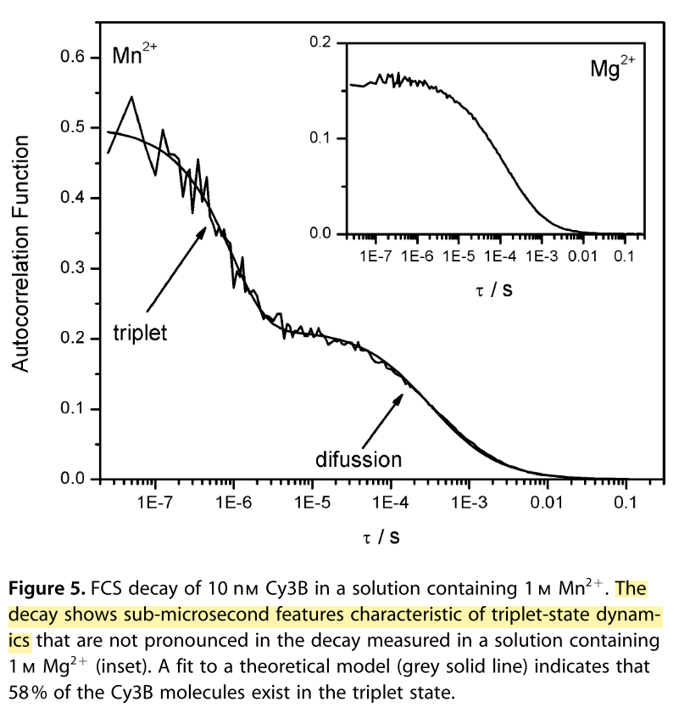
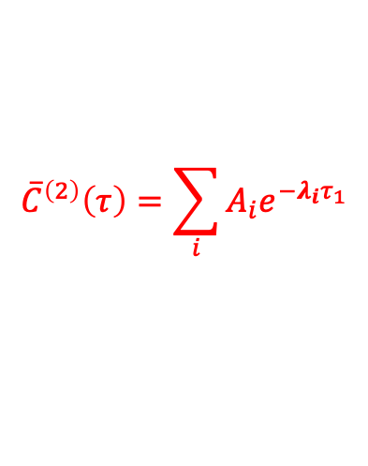
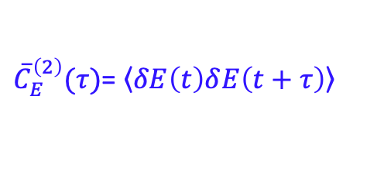
Photophysics of the Cyanine Fluorophores
Manganese (#25) is a metal, with paramagnetic ions ([Ar] 3d⁵ 4s²)
Manganese in pure form easily rust.
${\overline{C}}_{E}^{\left(2\right)}(τ)$= $\left\langle δE\left(t\right)δ\left.E\left(t+τ\right)\right\rangle \right.$
$${\overline{C}}^{\left(2\right)}\left(τ\right)=\sum_{i}{{A_{i}e}^{−λ_{i}τ_{1}}}$$
Construct/Condition | t₁
3’-p(dT)₁₅ + 0.0 µM gp32 | 2.9 µSec
3’-p(dT)₁₄ + 0.0 µM gp32 | 2.7 µSec
5’-p(dT)₁₅ + 0.0 µM gp32 | 3.2 µSec
5’-p(dT)₁₄ + 0.0 µM gp32 | 3.0 µSec
Manganese(II) chloride crystals
Ciuba, M. A., & Levitus, M. (2013). Manganese-Induced Triplet Blinking and Photobleaching of Single Molecule Cyanine Dyes
Notes:
The fastest decay is related to the formation of the triplet state.
Mn 2+ can stabilize the triplet state and increases the lifetime.
Paramagnetic molecules have permanent magnetic moments (dipoles) due to the spin of unpaired electrons

Slide 21
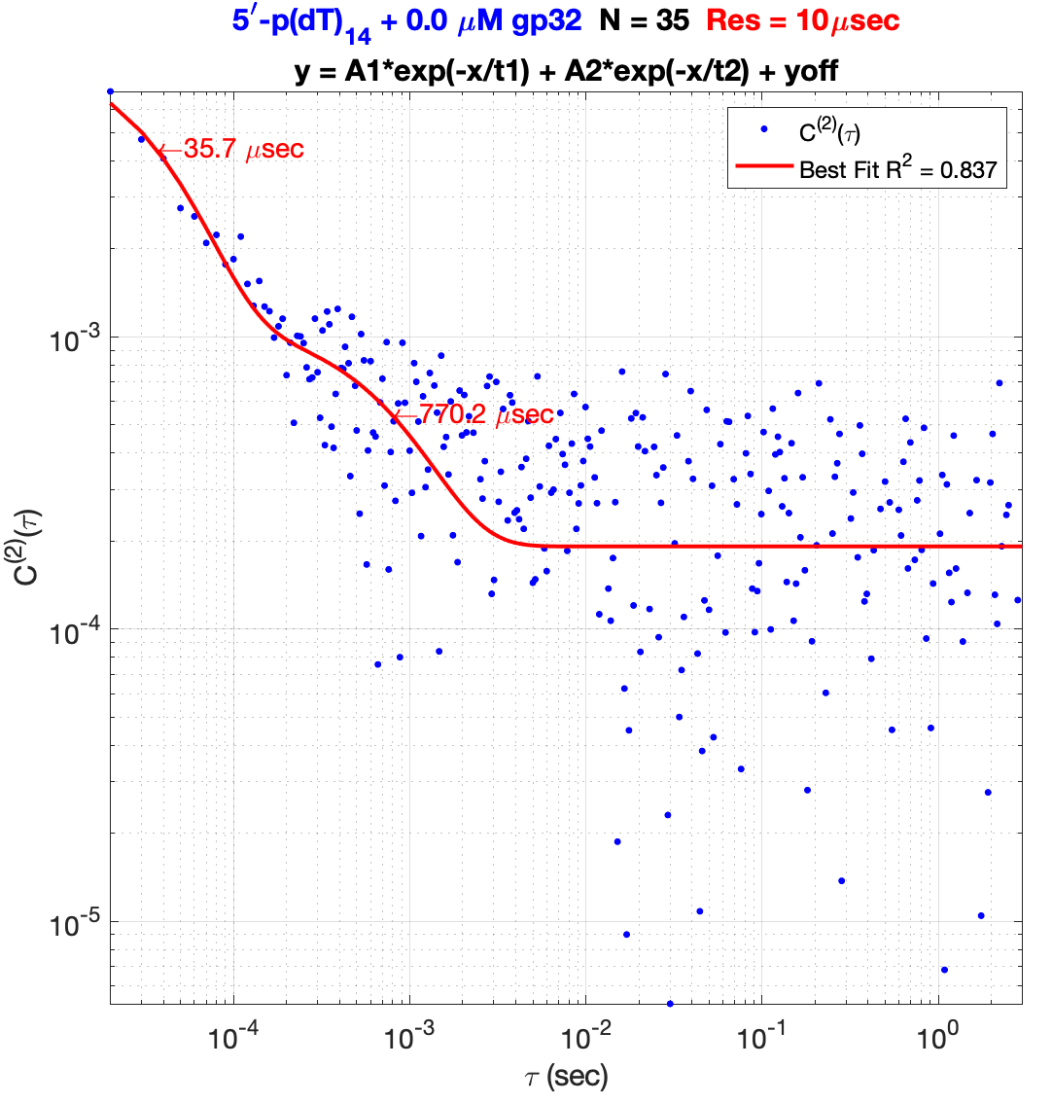
Hierarchy of possible fluctuations in DNA
Cy3
1) Photophysics of the dyes (nanosecond-microseconds)
2) Local Stacking /Unstacking Interactions (10’s of microseconds)
Cy5
Base stacking/unstacking

Slide 22
Hierarchy of possible fluctuations in DNA
Cy3
1) Photophysics of the dyes (nanosecond-microseconds)
2) Local Stacking /Unstacking Interactions (10’s of microseconds)
Cy5
Base stacking/unstacking

Slide 23
Hierarchy of possible fluctuations in DNA
Cy3
1) Photophysics of the dyes (nanosecond-microseconds)
2) Local Stacking /Unstacking Interactions (10’s of microseconds)
Cy5
Construct/Condition | t₂
3’-p(dT)₁₅ + 0.0 µM gp32 | 82 µSec
3’-p(dT)₁₄ + 0.0 µM gp32 | 46 µSec
5’-p(dT)₁₅ + 0.0 µM gp32 | 22 µSec
5’-p(dT)₁₄ + 0.0 µM gp32 | 36 µSec
Base stacking/unstacking

Slide 24
Hierarchy of possible fluctuations in DNA
Cy3
1) Photophysics of the dyes (nanosecond-microseconds)
2) Local Stacking /Unstacking Interactions (10’s of microseconds)
Cy5
Construct/Condition | t₂
3’-p(dT)₁₅ + 0.0 µM gp32 | 82 µSec
3’-p(dT)₁₄ + 0.0 µM gp32 | 46 µSec
5’-p(dT)₁₅ + 0.0 µM gp32 | 22 µSec
5’-p(dT)₁₄ + 0.0 µM gp32 | 36 µSec
Base stacking/unstacking

Slide 25
Hierarchy of possible fluctuations in DNA
Cy3
1) Photophysics of the dyes (nanosecond-microseconds)
2) Local Stacking /Unstacking Interactions (10’s of microseconds)
Cy5
Construct/Condition | t₂
3’-p(dT)₁₅ + 0.0 µM gp32 | 82 µSec
3’-p(dT)₁₄ + 0.0 µM gp32 | 46 µSec
5’-p(dT)₁₅ + 0.0 µM gp32 | 22 µSec
5’-p(dT)₁₄ + 0.0 µM gp32 | 36 µSec
Base stacking/unstacking

Slide 26
Hierarchy of possible fluctuations in DNA
1) Photophysics of the dyes (nanosecond-microseconds)
Cy3
2) Local Stacking /Unstacking Interactions (10’s of microseconds)
Cy5
3) Concerted global rearrangements of the ssDNA (100’s microseconds - milliseconds) - Collective base stacking changes - Backbone conformational changes
Construct/Condition | t₃
3’-p(dT)₁₅ + 0.0 µM gp32 | 1.2 mSec
3’-p(dT)₁₄ + 0.0 µM gp32 | 1.7 mSec
5’-p(dT)₁₅ + 0.0 µM gp32 | 8.3 mSec
5’-p(dT)₁₄ + 0.0 µM gp32 | 770.2 µSec
Concerted global rearrangements of the ssDNA

Slide 27
Hierarchy of possible fluctuations in DNA
1) Photophysics of the dyes (nanosecond-microseconds)
Cy3
2) Local Stacking /Unstacking Interactions (10’s of microseconds)
Cy5
3) Concerted global rearrangements of the ssDNA (100’s microseconds - milliseconds) - Collective base stacking changes - Backbone conformational changes
Construct/Condition | t₃
3’-p(dT)₁₅ + 0.0 µM gp32 | 1.2 mSec
3’-p(dT)₁₄ + 0.0 µM gp32 | 1.7 mSec
5’-p(dT)₁₅ + 0.0 µM gp32 | 8.3 mSec
5’-p(dT)₁₄ + 0.0 µM gp32 | 770.2 µSec
Concerted global rearrangements of the ssDNA

Slide 28
Hierarchy of possible fluctuations in DNA
1) Photophysics of the dyes (nanosecond-microseconds)
Cy3
2) Local Stacking /Unstacking Interactions (10’s of microseconds)
Cy5
3) Concerted global rearrangements of the ssDNA (100’s microseconds - milliseconds) - Collective base stacking changes - Backbone conformational changes
Construct/Condition | t₃
3’-p(dT)₁₅ + 0.0 µM gp32 | 1.2 mSec
3’-p(dT)₁₄ + 0.0 µM gp32 | 1.7 mSec
5’-p(dT)₁₅ + 0.0 µM gp32 | 8.3 mSec
5’-p(dT)₁₄ + 0.0 µM gp32 | 770.2 µSec
Concerted global rearrangements of the ssDNA

Slide 29
Hierarchy of possible fluctuations in DNA
Cy3
1) Photophysics of the dyes (nanosecond-microseconds)
2) Local Stacking /Unstacking Interactions (10’s of microseconds)
Cy5
3) Concerted global rearrangements of the ssDNA (100’s microseconds - milliseconds) - Collective base stacking changes - Backbone conformational changes
Construct/Condition | t₃
3’-p(dT)₁₅ + 0.0 µM gp32 | 1.2 mSec
3’-p(dT)₁₄ + 0.0 µM gp32 | 1.7 mSec
5’-p(dT)₁₅ + 0.0 µM gp32 | 8.3 mSec
5’-p(dT)₁₄ + 0.0 µM gp32 | 770.2 µSec
Concerted global rearrangements of the ssDNA

Slide 30
Hierarchy of possible fluctuations in DNA
Cy3
1) Photophysics of the dyes (nanosecond-microseconds)
2) Local Stacking /Unstacking Interactions (10’s of microseconds)
Cy5
3) Concerted global rearrangements of the ssDNA (100’s microseconds - milliseconds) - Collective base stacking changes - Backbone conformational changes
4) DNA-Breathing fluctuations at the Fork (milliseconds)
Construct/Condition | t₃
3’-p(dT)₁₅ + 0.0 µM gp32 | 1.2 mSec
3’-p(dT)₁₄ + 0.0 µM gp32 | 1.7 mSec
5’-p(dT)₁₅ + 0.0 µM gp32 | 8.3 mSec
5’-p(dT)₁₄ + 0.0 µM gp32 | 770.2 µSec
Fluctuations at the DNA primer-template junction

Slide 31
Hierarchy of possible fluctuations in DNA
Cy3
1) Photophysics of the dyes (nanosecond-microseconds)
2) Local Stacking /Unstacking Interactions (10’s of microseconds)
Cy5
3) Concerted global rearrangements of the ssDNA (100’s microseconds - milliseconds) - Collective base stacking changes - Backbone conformational changes
4) DNA-Breathing fluctuations at the junction (milliseconds)
Construct/Condition | t₃
3’-p(dT)₁₅ + 0.0 µM gp32 | 1.2 mSec
3’-p(dT)₁₄ + 0.0 µM gp32 | 1.7 mSec
5’-p(dT)₁₅ + 0.0 µM gp32 | 8.3 mSec
5’-p(dT)₁₄ + 0.0 µM gp32 | 770.2 µSec
Fluctuations at the DNA primer-template junction

Slide 32
Hierarchy of possible fluctuations in DNA
Cy3
Cy5
Fluctuations at the DNA primer-template junction

Slide 33
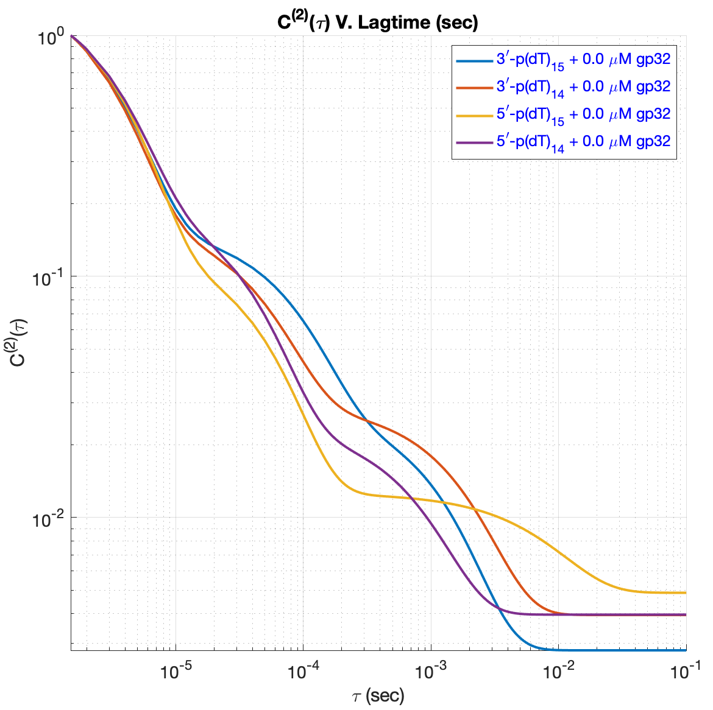
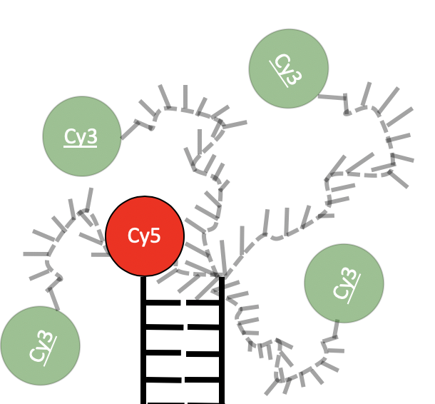
DNA Fork-Junctions: Four templates for gp32 binding
Single-stranded DNA of Two Different Polarities: 3` vs 5`
DNA only
Cy3
3`
Cy3
3`
Cy3
5`
Cy5
Cy5
Cy5
3`-p(dT)₁₅
5`-p(dT)₁₅
S1S2
S4S5
DNA only
Single-stranded DNA of Two Different Lengths: 14mer vs 15mer
Cy3
3`
Cy3
5`
Cy5
Cy5
3`-p(dT)₁₄
5`-p(dT)₁₄
S18S2
S19S5
Covalently modified ssDNA is ordered from IDT and annealed in lab to form DNA primer-template junctions

Slide 34
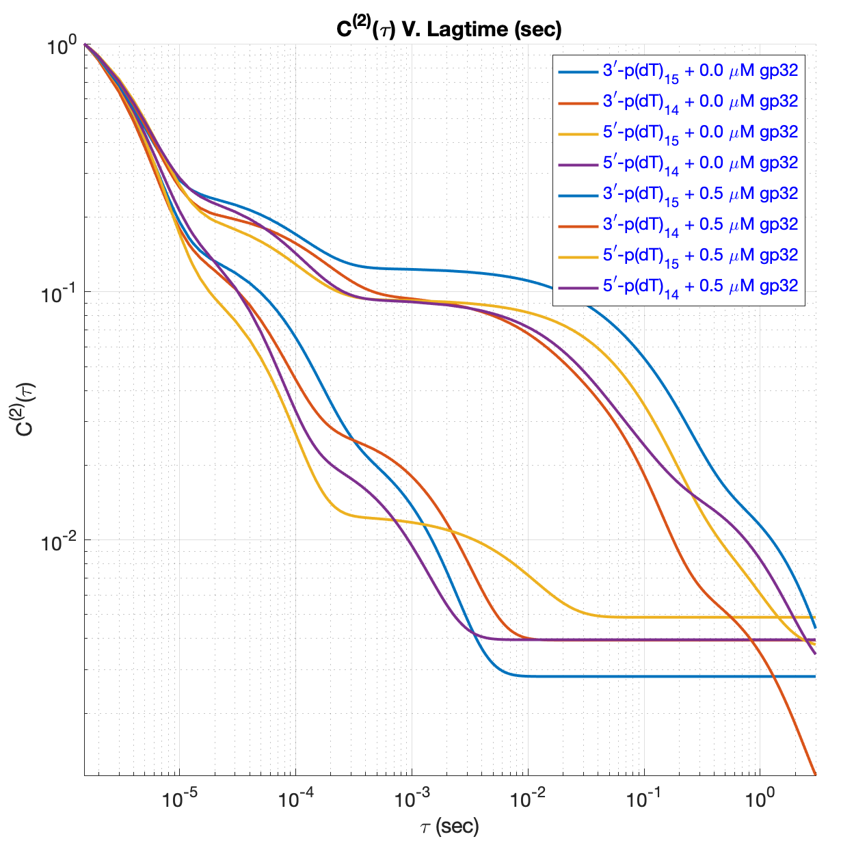

DNA Fork-Junctions: Four templates for gp32 binding
Single-stranded DNA of Two Different Polarities: 3` vs 5`
DNA only
Photoisomerization
Cy3
3`
Cy3
3`
Cy3
5`
Local Motions/ Triplet Dynamics
Cy5
Cy5
Cy5
+ 0.5µM gp32
3`-p(dT)₁₅
5`-p(dT)₁₅
DNA + 0.5µM gp32
S1S2
S4S5
DNA only
Single-stranded DNA of Two Different Lengths: 14mer vs 15mer
Cy3
3`
Cy3
5`
3`
Cy3
Cy5
Cy5
Cy5
3`-p(dT)₁₄
5`-p(dT)₁₄
S18S2
S19S5
Gp32 causes local motions to slow down and introduces new, longer decays

Slide 35
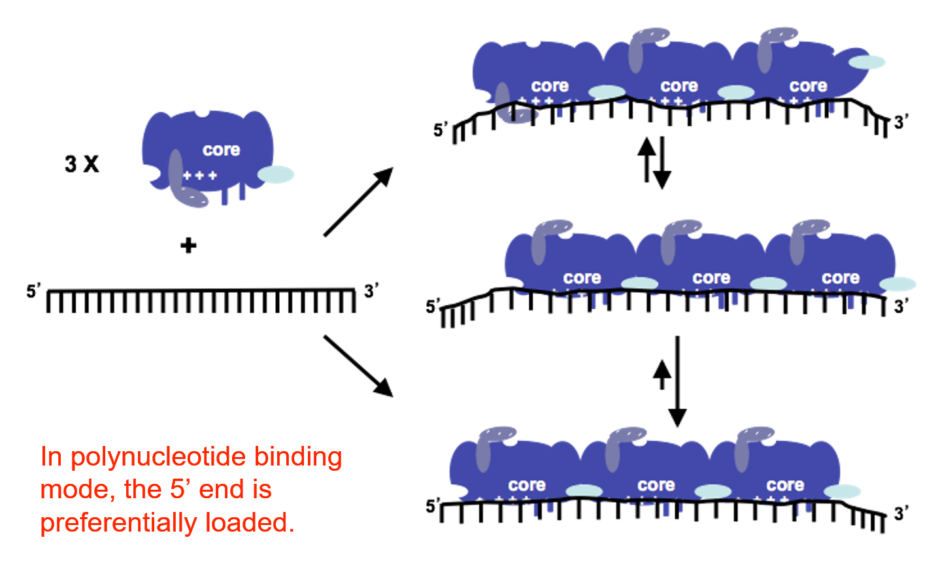
Polymeric (cooperative) binding modes of gp32
gp32 dimers preferentially perturbs bases at the 5’-end of a longer polynucleotide.
Jose et al. Nucleic Acids Res. (2015), 43, 9276-9290.

Slide 36
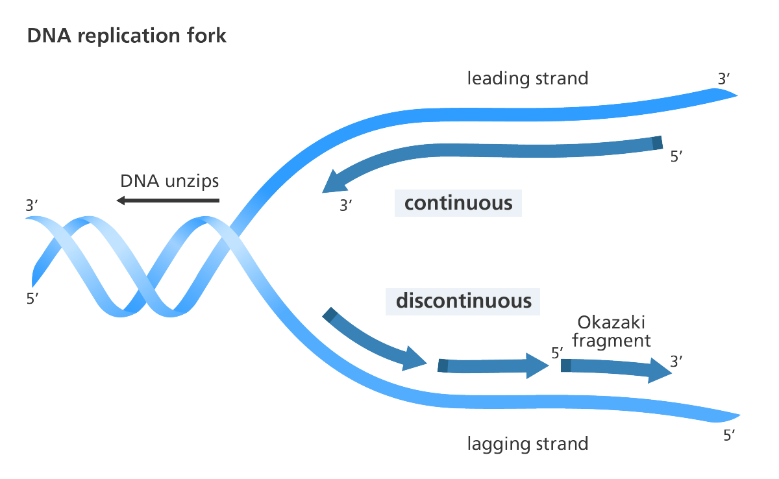

Mechanism of gp32 sliding
3`
5`
Cy3
Cy3
Cy5
Cy5
Vs.
B
5`
B
5`
S2
S1
S4
S5
3`-p(dT)₁₅
5`-p(dT)₁₅
gp32 dimers may slide toward the 5` end of ssDNA

Slide 37

Mechanism of gp32 sliding
On the 3` constructs, the fork may act like a bumper preventing the gp32 from falling off.
3`
5`
gp32 dimers may slide toward the 5` end of ssDNA

Slide 38
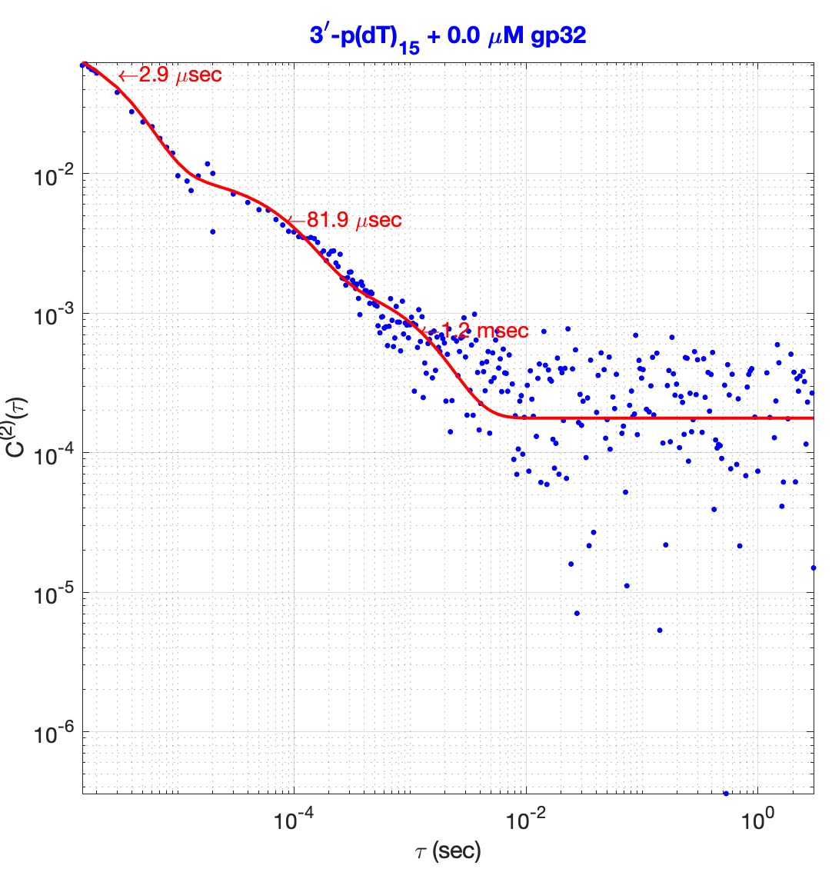
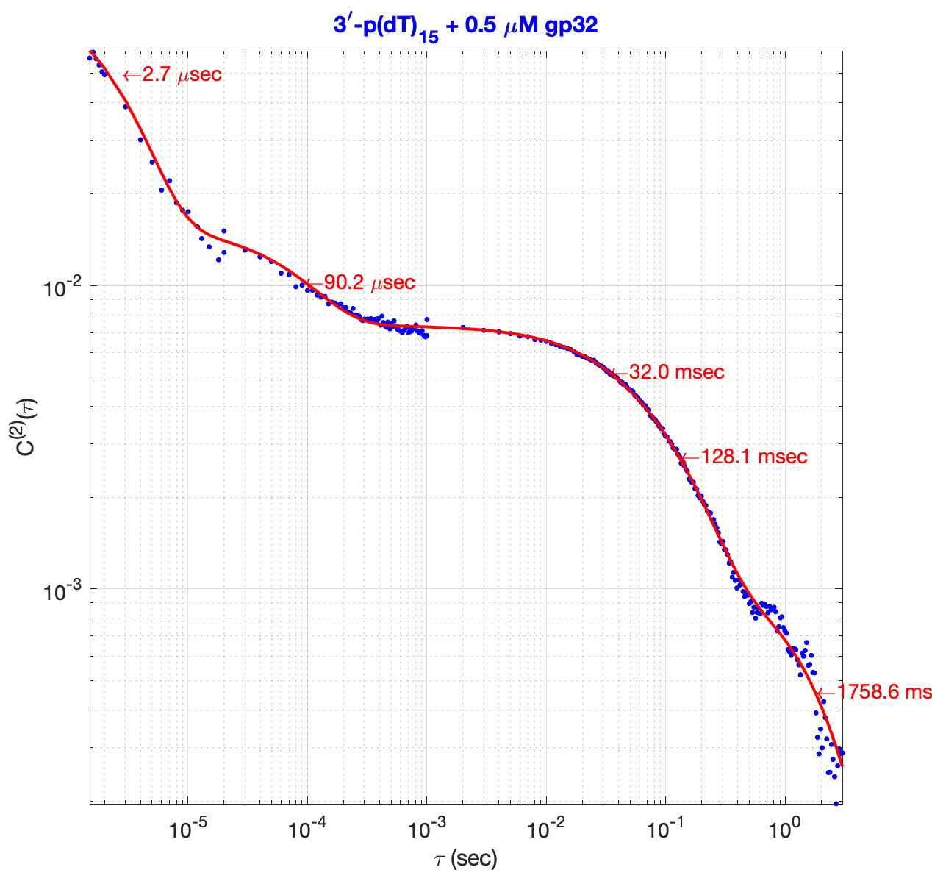
3`-p(dT)₁₅
DNA only
DNA + 0.5 µM gp32

Slide 39
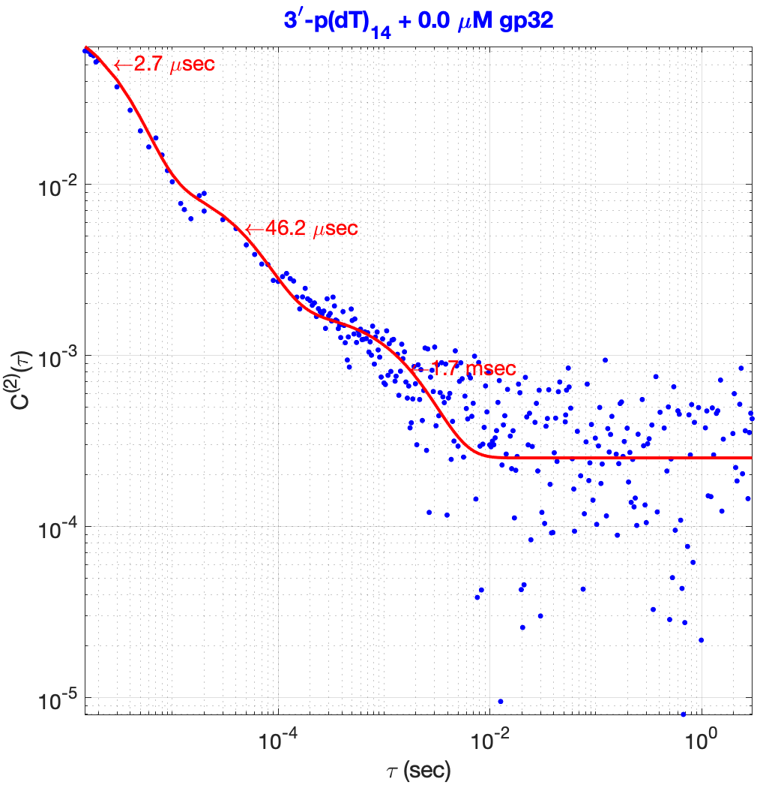
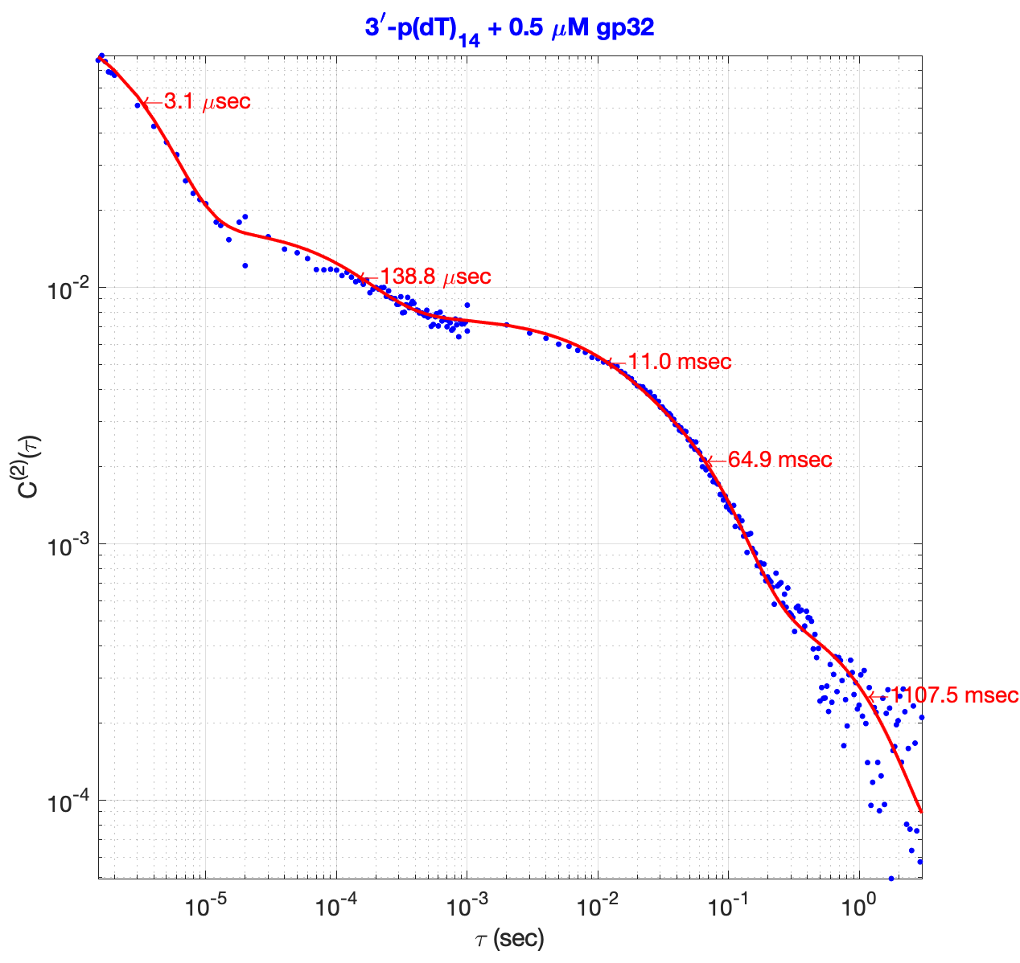
3`-p(dT)14
DNA only
DNA + 0.5 µM gp32

Slide 40
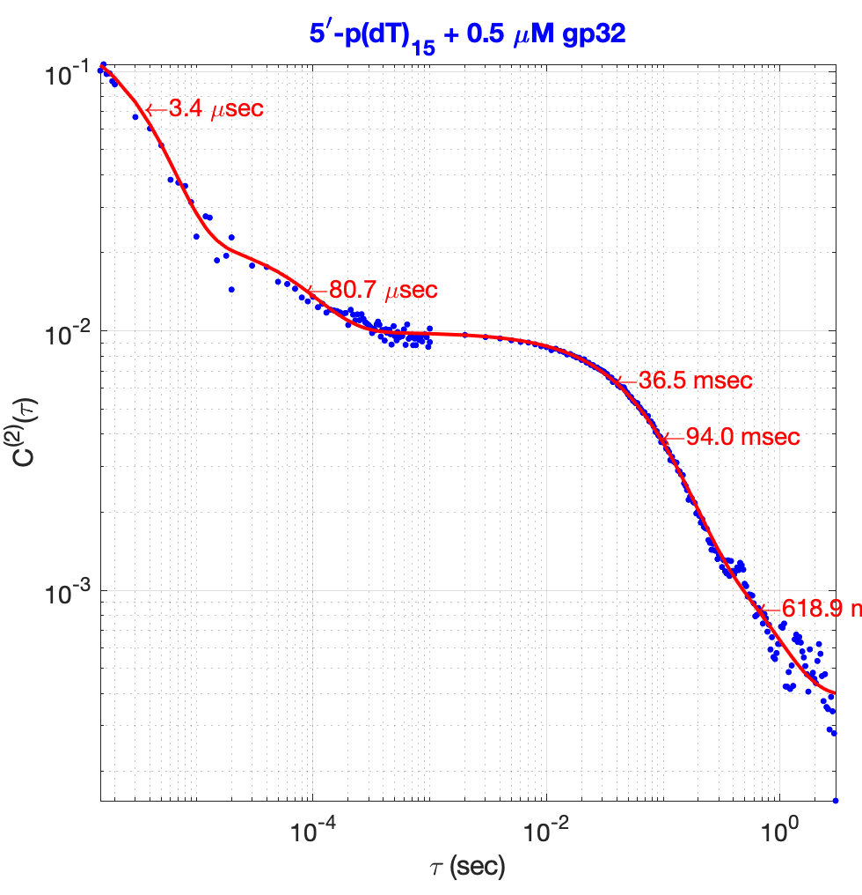
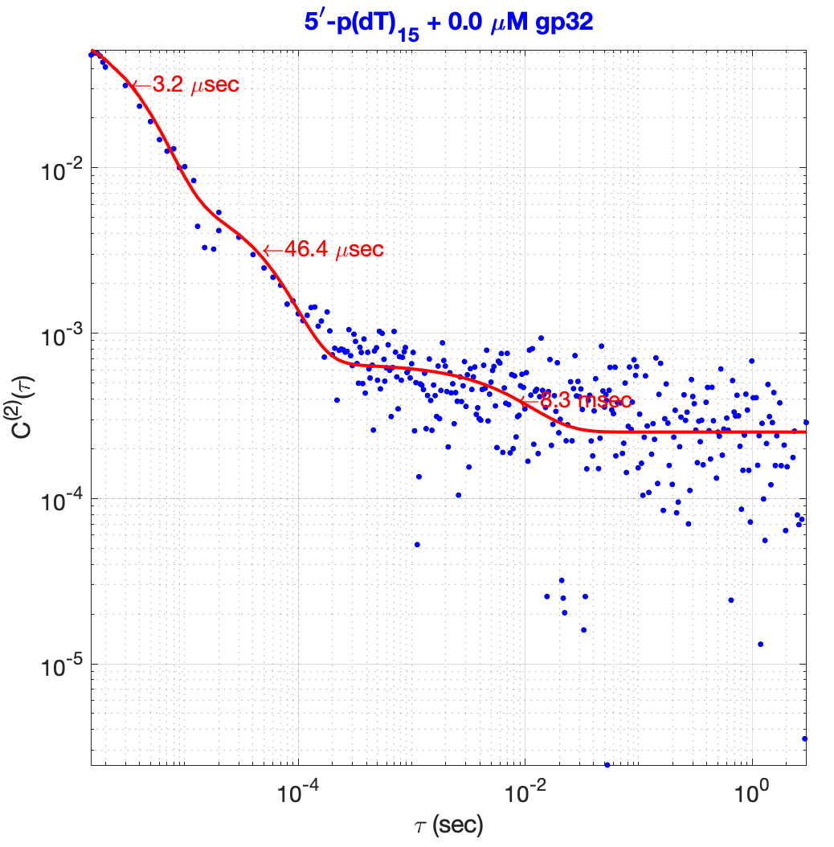
5`-p(dT)₁₅
DNA only
DNA + 0.5 µM gp32

Slide 41
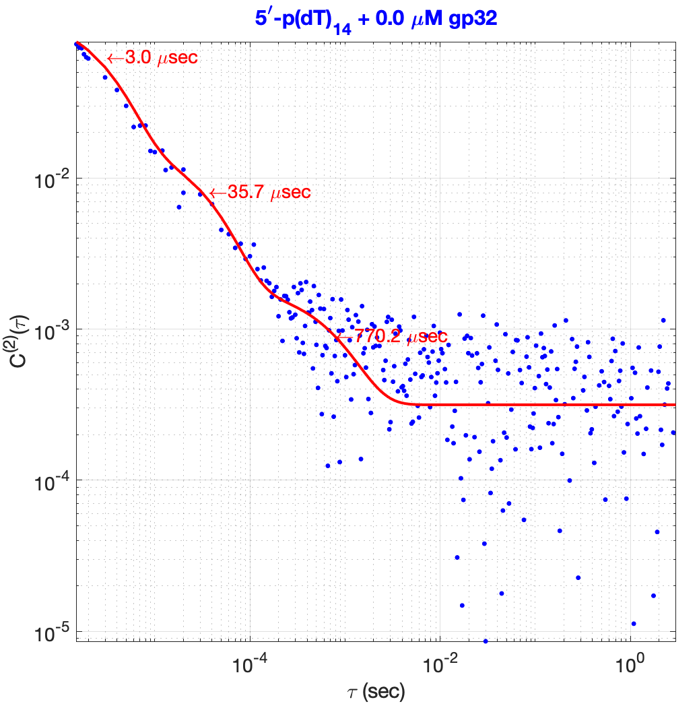
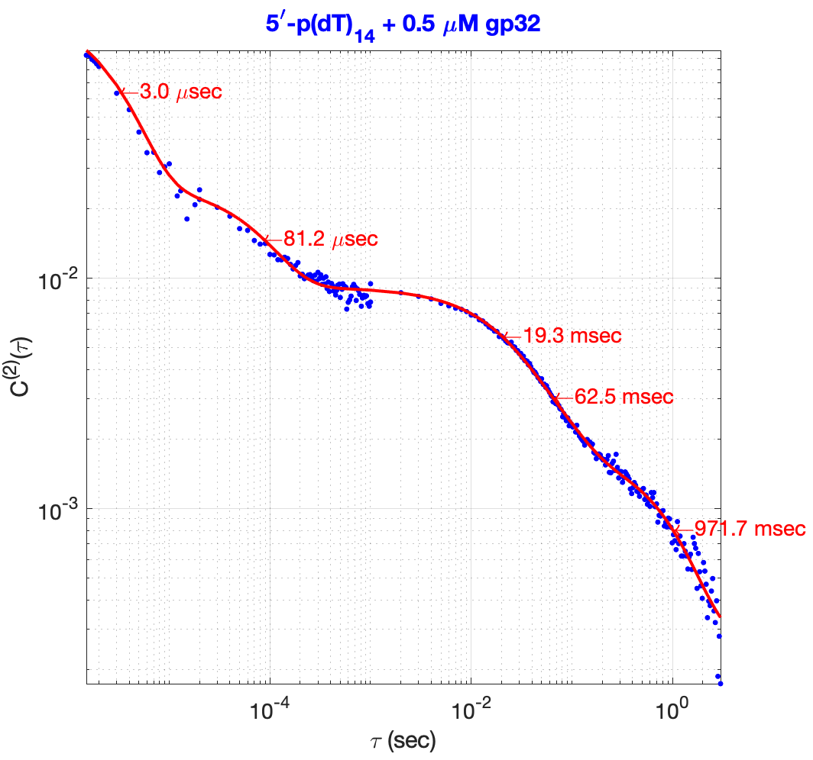
5`-p(dT)₁₄
DNA only
DNA + 0.5 µM gp32

Slide 42
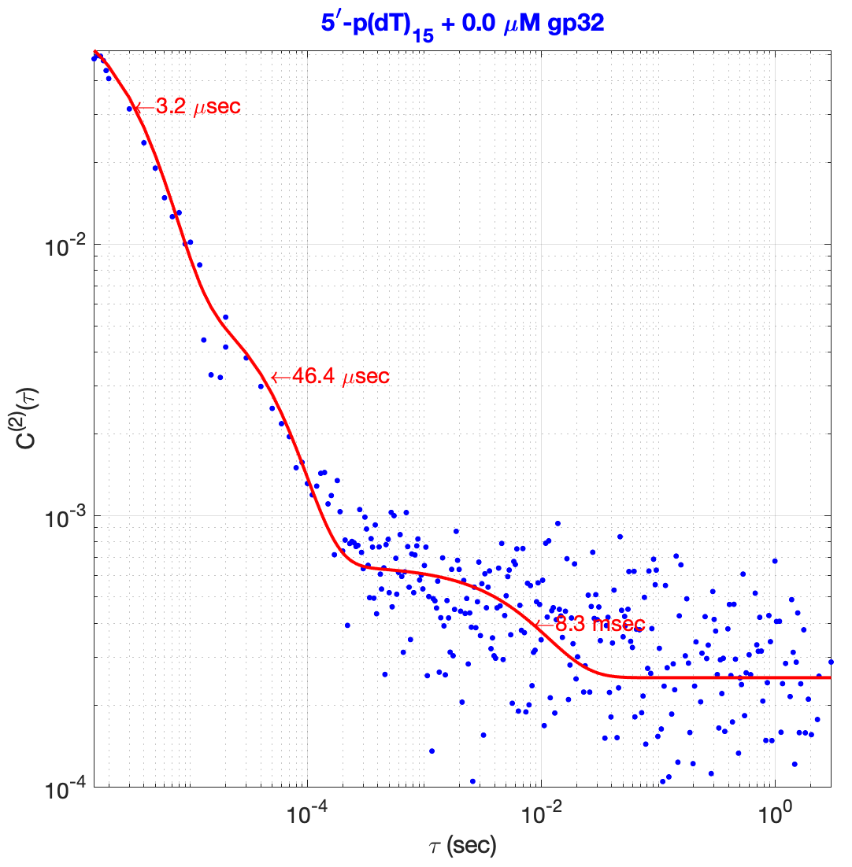
The microenvironment influences the rate of back-reaction away from the triplet state.

Slide 43

Results: The timescales of FRET Fluctuations
Time scales of gp32 dimer formation
Recovery to S_{0,Trans,}
SSDNA fluctuations
ssDNA Backbone
Fork Breathing Modes
1’→2
1→0
1→1`
0→1
2→1
𝜏₂
𝜏₃
𝜏₃
𝜏₄
𝜏₅
Photoisomerization
𝜏₁
𝜏₂
T*gp32→ S_{0,Trans}
Local ssDNA Fluctuations
1
Construct/Condition | t₁ | t₂ | t₃
3’-p(dT)₁₅ + 0.0 µM gp32 | 2.9 µSec | 82 µSec | 1.2 mSec
3’-p(dT)₁₄ + 0.0 µM gp32 | 2.7 µSec | 46 µSec | 1.7 mSec
5’-p(dT)₁₅ + 0.0 µM gp32 | 3.2 µSec | 22 µSec | 8.3 mSec
5’-p(dT)₁₄ + 0.0 µM gp32 | 3.0 µSec | 36 µSec | 0.77 mSec
0
1`
2
Construct/Condition | t₁ | t₂ | t₃ | t₄ | t₅
3’-p(dT)₁₅ + 0.5 µM gp32 | 2.7µSec | 90 µSec | 32 msec | 128 mSec | 1758.6 mSec
3’-p(dT)₁₄ + 0.5 µM gp32 | 3.1 µSec | 139 µSec | 11 msec | 65 mSec | 1107.5 mSec
5’-p(dT)₁₅ + 0.5 µM gp32 | 3.4 µSec | 81 µSec | 37 msec | 94 mSec | 618.9 mSec
5’-p(dT)₁₄ + 0.5 µM gp32 | 3.0 µSec | 81 µSec | 19 mSec | 63 mSec | 850 mSec
Notes:
Triplet state has a symmetry that allows the bond to freely rotate.

Slide 44

Conclusions: Trends in Eigen-timescales
𝜏₁ is the timescale of photoisomerization and triplet formation.
𝜏₂ is related to local fluctuations of ssDNA and which couple the triplet state back to the ground state.
𝜏₃ is related to global fluctuations of the ssDNA phosphate backbone
𝜏₃, 𝜏 ₄, & 𝜏 ₅ are dominated by interactions with the SSB.
Construct/Condition | t₁ | t₂ | t₃
3’-p(dT)₁₅ + 0.0 µM gp32 | 2.9 µSec | 82 µSec | 1.2 mSec
3’-p(dT)₁₄ + 0.0 µM gp32 | 2.7 µSec | 46 µSec | 1.7 mSec
5’-p(dT)₁₅ + 0.0 µM gp32 | 3.2 µSec | 22 µSec | 8.3 mSec
5’-p(dT)₁₄ + 0.0 µM gp32 | 3.0 µSec | 36 µSec | 0.77 mSec
Construct/Condition | t₁ | t₂ | t₃ | t₄ | t₅
3’-p(dT)₁₅ + 0.5 µM gp32 | 2.7µSec | 90 µSec | 32 msec | 128 mSec | 1758.6 mSec
3’-p(dT)₁₄ + 0.5 µM gp32 | 3.1 µSec | 139 µSec | 11 msec | 65 mSec | 1107.5 mSec
5’-p(dT)₁₅ + 0.5 µM gp32 | 3.4 µSec | 81 µSec | 37 msec | 94 mSec | 618.9 mSec
5’-p(dT)₁₄ + 0.5 µM gp32 | 3.0 µSec | 81 µSec | 19 mSec | 63 mSec | 850 mSec
Notes:
Cy dye in photoexcited state has a natural isomerization rate. In the presence of a surface, there is less room for the molecule to isomerize. The trans state is the more stable state and fluoresnt state.
Perhaps the fast t2 mode (local motion around chromophores) is affected differentially by the gp32. Both polarities get slowed (expected) but the 3`-constructs are slightly more slowed due to the different EM environments

Slide 45
Conclusions: Trends in Eigen-timescales
𝜏₁ is the timescale of photoisomerization and triplet formation. This is a purely photophysical process not affected by ssDNA length or polarity. The constructs’ first eigenmode was nominally affected by gp32. If gp32 marginally stabilizes the trans configuration ground state, this could inhibit the creation of the triplet state.
𝜏₂ is related to local fluctuations of ssDNA and which couple the triplet state back to the ground state. The microenvironment around the probe is known to affect this process. With only DNA present the trend is that the 3` constructs have eigenfrequencies which last longer than 5` constructs. When gp32 is added, there is a noticeable increase in time of the second eigenmode. Biggest differences are between the polarities now rather than length.
𝜏₃ is related to global fluctuations of the ssDNA phosphate backbone. One construct is an outlier. the timescale of fluctuations are uncorrelated to ssDNA length or ssDNA polarity.
𝜏₃, 𝜏 ₄, & 𝜏 ₅ are dominated by interactions with the SSB. Gp32 binds to the ssDNA and slows down its fluctuations. In association cases (𝜏₃, 𝜏₄) the 15mers are more affected than their 14mer counterparts. The first rate which isn’t dominated by length differences is the slowest mode 𝜏₅. The fifth Eigenmode is likely dominated by the dissociation of the dimer. If the dimer prefers the 5` end, then the dimer at the terminal end on the 5` constructs would have the shorter time constants.
Construct/Condition | t₁ | t₂ | t₃
3’-p(dT)₁₅ + 0.0 µM gp32 | 2.9 µSec | 82 µSec | 1.2 mSec
3’-p(dT)₁₄ + 0.0 µM gp32 | 2.7 µSec | 46 µSec | 1.7 mSec
5’-p(dT)₁₅ + 0.0 µM gp32 | 3.2 µSec | 22 µSec | 8.3 mSec
5’-p(dT)₁₄ + 0.0 µM gp32 | 3.0 µSec | 36 µSec | 0.77 mSec
Construct/Condition | t₁ | t₂ | t₃ | t₄ | t₅
3’-p(dT)₁₅ + 0.5 µM gp32 | 2.7µSec | 90 µSec | 32 msec | 128 mSec | 1758.6 mSec
3’-p(dT)₁₄ + 0.5 µM gp32 | 3.1 µSec | 139 µSec | 11 msec | 65 mSec | 1107.5 mSec
5’-p(dT)₁₅ + 0.5 µM gp32 | 3.4 µSec | 81 µSec | 37 msec | 94 mSec | 618.9 mSec
5’-p(dT)₁₄ + 0.5 µM gp32 | 3.0 µSec | 81 µSec | 19 mSec | 63 mSec | 850 mSec
Notes:
Cy dye in photoexcited state has a natural isomerization rate. In the presence of a surface, there is less room for the molecule to isomerize. The trans state is the more stable state and fluoresnt state.
Perhaps the fast t2 mode (local motion around chromophores) is affected differentially by the gp32. Both polarities get slowed (expected) but the 3`-constructs are slightly more slowed due to the different EM environments

Slide 46

Hierarchy of possible fluctuations in DNA
Cy3
Cy5
Fluctuations at the DNA primer-template junction

Slide 47









Flow: Calculating ${\overline{D}}^{(4)}$ for the 3`-p(dT)₁₅ DNA + 0.5 µM gp32
$$C^{(4)}\left(τ_{1}{,τ}_{2},τ_{3}\right)=\left\langle δE\left(0\right)δE\left(τ_{1}\right)δE\left(τ_{2}\right)δE\left(τ_{3}\right)\right\rangle$$
${\overline{C}}_{E}^{\left(2\right)}(τ)$= $\left\langle δE\left(t\right)δ\left.E\left(t+τ\right)\right\rangle \right.$
$C^{(4)}\left(τ_{1}{,τ}_{2},τ_{3}\right)$ = $\sum_{j}{\sum_{i}{\left[\left(A_{i}A_{j}+A_{ij}\left(τ_{2}\right)\right)e^{−λ_{i}τ_{1}}e^{−λ_{j}τ_{3}}\right]}}$
Fig 1. The second-order time correlation function reveals the timescales of conformational change and Photophysics.
Fig 2. Fit to the fourth-order time correlation function indicates the extent and nature of mode-mode correlation.
$${\overline{C}}^{\left(2\right)}\left(τ\right)=\sum_{i}{{A_{i}e}^{−λ_{i}τ_{1}}}$$
${\overline{C}}^{(4)}=C^{(4)}$- ${\overline{C}}^{(2)}{\overline{C}}^{(2)}$
${\overline{ D}}^{(4)}\left(τ_{1}{,τ}_{2},τ_{3}\right)$ = $\frac{∂^{2}{\overline{ C}}^{(4)}\left(τ_{1}{,τ}_{2},τ_{3}\right)}{∂\log{τ_{1}}∂\log{τ_{3}}}$
Fig 3. The fourth-order difference correlation function has the contribution from C⁽²⁾ removed.
Fig 4. The fourth-order decay function ${\overline{ D}}^{(4)}$is peaked at the time-constants of${\overline{ C}}^{(2)}$ and shows the eigenmode coupling of $\overline{ C}$⁽⁴⁾.
3`-p(dT)₁₅ + 0.5 uM gp32
Notes:
A11 = 0.002134 (4.504e-05, 0.004223)
A12 = -0.001169 (-0.00195, -0.0003886)
A13 = -0.001728 (-0.001996, -0.001459)
A14 = 0.0002575 (0.0001351, 0.0003798)
A22 = 0.003878 (0.003493, 0.004264)
A23 = 0.0004992 (0.0003681, 0.0006303)
A24 = -0.0009868 (-0.00104, -0.0009336)
A33 = 0.0002781 (0.0002138, 0.0003424)
A34 = 0.0004351 (0.0004093, 0.0004609)
A44 = 0.001342 (0.001328, 0.001356)

Slide 48

3`-p(dT)₁₅ DNA + 0.0 µM gp32
For DNA only, we Multiply A11 by 0.1 to scale the colormap better
Zoomed in

Slide 49

3`-p(dT)₁₄ DNA + 0.0 µM gp32
3`-p(dT)₁₄ + 0.0 uM gp32

Slide 50

5`-p(dT)₁₅ DNA + 0.0 µM gp32
5`-p(dT)₁₅ + 0.0 uM gp32
Notes:
The fast motions can be negatively coupled to the slow process if the cis-trans isomerization leasds to a change in fret that is opposite (down), cis to trans is slower and makes the fret go up

Slide 51

5`-p(dT)₁₄ DNA + 0.0 µM gp32
5`-p(dT)₁₄ + 0.0 uM gp32

Slide 52

How are eigenmodes correlated?
Negative amplitude A_{ij} means if the system has amplitude in mode (𝝀_{i}), then this lessens the conditional probability of seeing the other mode (𝝀_{j}) in the next moment (𝜏₂=0).
Positive self-amplitude A_{ii} means there is an increased chance the system will remain in this eigenmode after a duration of time 𝜏₂.
Base stacking (subset of 𝝀₂) is negatively correlated to global motions which increase the FRET
The highest amplitude (by far) is A₁₁ which relates to the rate of excited state dynamics. Here we scale it by a multiplicative factor of M = 0.1.
Positive off-diagonal amplitude A_{ij} means if the system has amplitude in mode (𝝀_{i}), then this increases the conditional probability of seeing the other mode (𝝀_{j}) in the next moment (𝜏₂=0).
M = 0.1
Photophysics
ssDNA Global motions/
Junction Interactions
Local Modes
Base stacking
Notes:
A fluctuation in signal which makes the FRET rise will tend to lessen the chance you see a signal which causes the signal to drop later.
A positive change (ends closer together) is negatively correlated to the process where the FRET goes down.
A23: Bases stacking is negatively correlated to global motions of the fret.

Slide 53
3`-p(dT)₁₅ DNA + 0.0 µM gp32
5`-p(dT)₁₅ DNA + 0.0 µM gp32
Notes:
DNA only: If the first mode is the S₀ → T mode, we say it is positively correlated to the backwards process and negatively correlated to fluctuations of the ssDNA backbone.
Motions that open the fork at the junction might be uncorrelated to motions that stack nucleotides

Slide 54
3`-p(dT)₁₄ DNA + 0.0 µM gp32
5`-p(dT)₁₄ DNA + 0.0 µM gp32

Slide 55

How are eigenmodes correlated when Protein is present?
2→ 0
0→1
Global/
1`→ 2
Local modes
T → S₀
S₀ → T
Photophysics
Local modes
Global/
1`→ 2
0→1
2→ 0
Notes:
Hierarchy of length and time scales seen in DNA only
Photophysics
Local base stacking/unstacking
Concerted global rearrangements of the ssDNA (collective base stacking changes, backbone conformational changes).
Breathing motions at fork junctions
Duplex DNA Conformations

Slide 56

3`-p(dT)₁₅ DNA + 0.5 µM gp32
3`-p(dT)₁₅ + 0.5 uM gp32
Notes:
Caxis = -Inf 0.300000000000000

Slide 57

3`-p(dT)₁₄ DNA + 0.5 µM gp32
3`-p(dT)₁₄ + 0.5 uM gp32

Slide 58

5`-p(dT)₁₅ DNA + 0.5 µM gp32
5`-p(dT)₁₅ + 0.5 uM gp32

Slide 59

5`-p(dT)₁₄ DNA + 0.5 µM gp32
5`-p(dT)₁₄ + 0.5 uM gp32

Slide 60

3`-p(dT)₁₅ DNA + 0.5 µM gp32
5`-p(dT)₁₅ DNA + 0.5 µM gp32

Slide 61


3`-p(dT)₁₄ DNA + 0.5 µM gp32
5`-p(dT)₁₄ DNA + 0.5 µM gp32
Notes:
Also in sample with protein the photoisomerization is negatively correlated to the global motions.
A45 is always negative

Slide 62

3`-p(dT)₁₅ DNA + 0.5 µM gp32
5`-p(dT)₁₅ DNA + 0.5 µM gp32
Like DNA only, the strongest correlation is between photoisomerization modes closely followed by correlations between backbone fluctuations.
All constructs show strong anticorrelation between photoisomerization and the global motions of the ssDNA at tau2 = 0 as well as with the slowest state (gp32 disassembly)
Mix of +/- correlation for the protein Data sets
3`-p(dT)₁₄ DNA + 0.5 µM gp32
5`-p(dT)₁₄ DNA + 0.5 µM gp32

Slide 63

$C^{(4)}\left(τ_{1},τ_{2},τ_{3}\right)$ for various $τ_{2}$
How do the 4-point correlations change with 𝝉₂?
What are the differences in the coupling constant between constructs?
What are the exchange timescales?
3`-p(dT)₁₅ + 0.5 uM gp32

Slide 64



3`-p(dT)₁₅ DNA + 0.5 µM gp32
5`-p(dT)₁₅ DNA + 0.5 µM gp32
A_{ii} mainly positive
A₁₃ negative
A₁₂ total mix
A₁₃ Mainly negative
A₂₃ always low correlations
3`-p(dT)₁₄ DNA + 0.5 µM gp32
5`-p(dT)₁₄ DNA + 0.5 µM gp32

Slide 65





3`-p(dT)₁₅ + 0.5 µM gp32
Decay spectra as a function of lag-time
Notes:
This is with Normailzed D4

Slide 66





3`-p(dT)₁₄ + 0.5 µM gp32
Decay spectra as a function of lag-time

Slide 67





5`-p(dT)₁₄ DNA + 0.5 µM gp32
Decay spectra as a function of lag-time

Slide 68





5`-p(dT)₁₅ DNA + 0.5 µM gp32
Decay spectra as a function of lag-time

Slide 69


3`-p(dT)₁₅ DNA + 0.5 µM gp32
5`-p(dT)₁₅ DNA + 0.5 µM gp32

Slide 70
3`-p(dT)₁₄ DNA + 0.5 µM gp32
5`-p(dT)₁₄ DNA + 0.5 µM gp32

Slide 71
FIN

Slide 72
Extra Slides

Slide 73




Which physical process is responsible for the various decays?
Photoisomerization of the C-C bond in the polymethine chain of the excited state Cyanine molecule yields a non-fluorescent ground state photoisomer (the cis- configuration).
Conversion back to the trans- state can take micro- to milliseconds depending on the local environment.
Cooper. (2004) Cy3B™: Improving the Performance of Cyanine Dyes. Journal of Fluorescence 2004
Cy3B is inhibited from this photoisomerization
Ciuba, M. A., & Levitus, M. (2013). Manganese-Induced Triplet Blinking and Photobleaching of Single Molecule Cyanine Dyes
Notes:
Cyanine Dye photophysics are characterized by efficient photoisomerization around a carbon-carbon bond of the polymethine chain from the first excited state. This process yields a ground-state photoisomer with a negligible fluorescence quantum yield that returns back to the thermodynamically stable all-trans ground state in the micro- to millisecond timescale.
They claim that the 5` attachment has a higher QY becayse

Slide 74




Photophysics of Cyanine Dyes: PIFE Effect
Time-resolved fluorescence lifetime.
﻿Time-resolved fluorescence anisotropy.
Nguyen, B., Ciuba, M. A., Kozlov, A. G., Levitus, M., & Lohman, T. M. (2019). Protein Environment and DNA Orientation Affect Protein induced Cy3 Fluorescence Enhancement (PIFE). Biophysical Journal
Notes:
Figure1:
In DNA only there was no difference in lifetime, but with protein there was.

Slide 75

Photophysics of Cyanine Dyes: PIFE Effect
Lerner, E., Ploetz, E., Hohlbein, J., Cordes, T., & Weiss, S. (2016). A Quantitative Theoretical Framework For Protein-Induced Fluorescence Enhancement − Förster-Type Resonance Energy Transfer (PIFE-FRET). https://doi.org/10.1021/acs.jpcb.6b03692

